Slide 1
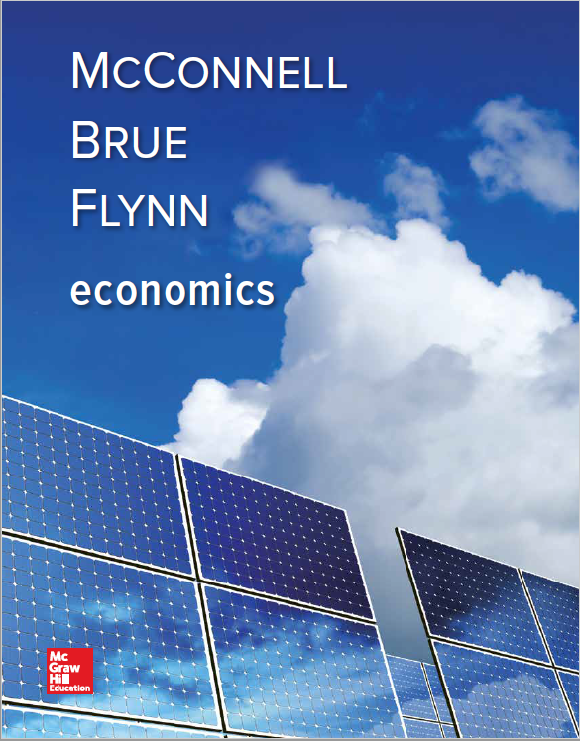
Chapter 35
The Balance of Payments, Exchange Rates, and Trade Deficits
Notes:
This chapter takes a look at a country’s balance of payments, which essentially records all transactions that take place between one country and all the others. In this discussion, we will investigate how official reserves are used to ensure that the balance of payments does balance. Then we will look at how exchange rates are determined and different types of exchange rate systems. Lastly, we will learn about U.S. trade deficits and determine their impacts on the U.S. economy.

Slide 2
International Transactions
International trade
Buy/sell current goods or services
Imports and exports
International asset transactions
Buy/sell real or financial assets
Buy stock
Sell your house to a foreigner
Requires currency exchange
LO1
Notes:
When individuals who participate in transactions use the same currency, the transaction exchange is a simple matter since both parties are using the same currencies. When the parties involved are from countries that use different currencies, an intermediate asset transaction must take place first so that the buyer will have the correct currency with which to pay the seller. The process of exchanging currencies creates a market in which a rate of exchange can be determined at an equilibrium rate to clear the market.

Slide 3
Balance of Payments
Sum of international financial transactions
Current account
Balance on goods and services
Net investment income
Net transfers
Balance on current account
LO2
Notes:
The balance of payments is the sum of all international financial transactions taking place between the a nation’s residents and the residents of foreign nations. These transactions primarily fall into either international trade or international asset exchange categories. In the U.S., the Commerce Department’s Bureau of Economic Analysis compiles a balance-of-payments statement each year. It is organized into two main categories: the current account and the capital and financial account. The current account summarizes U.S. trade in currently produced goods and services. Exports are a plus and imports are a minus. In 2015, the balance of goods was negative $760 billion which represents a trade deficit. Looking at services, there was a surplus of exports over imports, leaving a balance of positive $219 billion. Also included in the current account is net investment income which represents the difference between (1) the interest and dividend payments foreigners paid U.S. citizens and companies for services provided, and (2) the interest and dividends the U.S. citizens and companies paid for the services provided by foreign capital invested here. In 2015 the U.S. net investment income was a positive $191 billion. The final component of the current account is net transfer, both public and private. This includes foreign aid, retirement funds paid to U.S. citizens living abroad, and money sent by immigrants back to their native country. In 2015 that was a negative $136 billion. Adding it all up, the current account in 2015 was a negative $486 billion. This means we had more money going out than coming in.

Slide 4
Balance of Payments Continued
Capital and financial account
Capital account
Financial account
Balance of payments accounts sum to zero
Current account deficits generate asset transfers to foreigners
Official reserves
LO2
Notes:
The second component of the balance of payments summarizes the international asset transactions. The capital and financial account consists of the capital account, which mainly measures debt forgiveness, and the financial account, which deals with international purchases and sales of real or financial assets. The capital account had a $0 balance in 2015, which indicates that the U.S. forgave exactly as much loans to other countries than other countries forgave in our loans. In the financial account, the balance was a positive $486 billion, which is not necessarily a good thing, as it indicates we sold more of our real and financial assets to foreign investors than they sold to us.

Slide 5
Balance of Payments Concluded
LO2
Notes:
The balance of the current account and the balance in the capital and financial account always must balance to zero.

Slide 6
U.S. Trade Balances
LO2
Notes:
This graph illustrates the U.S. trade balances with selected nations in 2015. Note that we had large trade deficits with several nations including China and Mexico, but we had trade surpluses with other nations such as the United Kingdom and Brazil.

Slide 7
Flexible Exchange Rates
The Market for Foreign Currency
(Pounds)
P
S₁
Exchange
Rate: $2 = £1
$3
Dollar
Depreciates
(Pound
Appreciates)
Dollar Price of 1 Pound
$2
Dollar
Appreciates
(Pound
Depreciates)
$1
D₁
0
Q₁
Q
Quantity of Pounds
LO3
Notes:
The demand for pounds is downward sloping, meaning that as the pound becomes less expensive in terms of dollars, more British goods and services will be purchased since they will be cheaper. The supply for pounds curve is upsloping because the British will purchase more U.S. goods when the dollar price of pounds rises. When that happens, the British will buy more U.S. goods and services because they will become less expensive.

Slide 8
Flexible Exchange Rates Determinants
Factors that shift demand/supply
Changes in tastes
Relative income changes
Relative price-level changes
Purchasing-power-parity theory
Relative interest rates
Relative expected returns on assets
Speculation
LO3
Notes:
There are many factors that can cause a nation’s currency to appreciate or depreciate but the basic laws of supply-demand apply. If the demand for a nation’s currency increases, that nation’s currency will appreciate and vice versa if the demand drops. If the supply of currency increases, it will depreciate and if one country’s currency appreciates, some other country’s currency will depreciate relative to it. So, what causes supply or demand to shift? Any change in consumer’s tastes will, of course, cause the demand for the currency to change. The change in income relative to the income in other nations will also shift demand, as will relative inflation rate changes. Under the purchasing-power-parity theory, exchange rates should eventually adjust such that they equate the purchasing power of various currencies. Many people use the “Big Mac” example. Since McDonald’s is located in almost every country, we can look at how much a Big Mac costs in each nation and then convert that to an exchange rate. Inflation can skew the numbers if one nation’s rate is different than the other’s. Interest rates and expected returns on assets can also affect demand if their relative rates are different between the nations. Another factor is speculation. Speculators are people who buy and sell currency solely to make money in the classic “buy low, sell high” process. These speculators can cause shifts in supply and demand.

Slide 9
Flexible Exchange Rates Disadvantages
Volatility
Uncertainty and diminished trade
Terms-of-trade changes
Instability
LO3
Notes:
Flexible exchange rates are not without their disadvantages. They can be volatile and unpredictable and because of that, they may discourage international trade. This instability can destabilize domestic economies as the wide fluctuations stimulate and then depress industries involved in exporting goods. This is even more apparent in nations whose exports and imports are a large part of their total domestic output.

Slide 10
Flexible Exchange Rates Continued
LO3
Notes:
This graph shows the dollar per pound exchange rate, which has been primarily determined by market forces with some government intervention.

Slide 11
Fixed Exchange Rates
Government intervention
Elimination of foreign exchange market
Official reserves used to maintain rate
Trade policies
Exchange controls and rationing
Domestic macroeconomic adjustments
LO4
Notes:
Sometimes nations use fixed or “pegged” rates to try to avoid the disadvantages of flexible rates. If the rate is fixed, a shift in the demand or supply of the currency will threaten the system and the government must intervene to keep the rate fixed. The government can use official reserves and engage in currency interventions of buying and selling their currency, in order to maintain the fixed rate. It can also try trade policies to discourage imports and encourage exports, but these types of policies can reduce the volume of world trade and can lead to retaliation by other nations in response to the trade restrictions. They can use exchange controls, whereby the government assumes the role of allocating the short supply of the foreign currency to importers, but this can cause the creation of a black market in the currency, charges of favoritism toward select importers, or distorted trade. The government could also use macroeconomic adjustments domestically to try to eliminate the shortage of the foreign currency.

Slide 12
Fixed Exchange Rates Continued
LO3
Notes:
A decrease in the demand for pounds, all other things equal, would cause a U.S. balance of payments deficit. This deficit would be corrected by a change in the exchange rate. Under fixed exchange rates, the US would have to cover the shortage by selling official reserves, restricting trade, implementing exchange controls, or enacting a contractionary stabilization policy and resulting in an increase in foreign exchange reserves.

Slide 13
Fixed Exchange Rates Concluded
Notes:
An increase in the demand for pounds, all other things equal, would cause a U.S. balance of payments surplus. This surplus would be corrected by a change in the exchange rate. Under fixed exchange rates, the US would have to cover the surplus by selling to decrease in foreign exchange reserves..

Slide 14
The Managed Float
Gold standard 1879-1934
Fixed exchange rate system
Bretton Woods 1944-1971
Fixed exchange rate system indirectly tied to gold
Managed float 1971-present
LO5
Notes:
Over the years, most nations have used three different exchange systems. The gold standard was used for the longest period. Under this standard, a nation’s currency was tied to its supply of gold, which created a fixed exchange rate. The Bretton Woods system was almost a hybrid system that allowed nations to transition to the modern day managed float system.

Slide 15
The Managed Float Continued
Dependence on foreign exchange markets
Occasional intervention
In support of managed float
Concerns with managed float
LO5
Notes:
Under the current managed floating exchange system, exchange rates among major currencies are free to float to their equilibrium market levels, but nations occasionally use currency intervention to stabilize or alter market rates. The nations recognize the importance of allowing the rates to adjust on their own, but also the importance of maintaining stability in the market. Proponents argue that the system has worked for many years and has weathered severe economic turbulence during that time. The critics argue that we need more stable exchange rates and need more government intervention to manage the float. The current system does seem to be the best compromise between the extreme of a true fixed exchange rate system and a fully free floating system.

Slide 16
U.S. Trade Deficit
Large and persistent
Causes of trade deficits
High U.S. growth (relatively)
China
Low U.S. saving rate
Implications of trade deficits
Increased current consumption
Increased indebtedness
LO6
Notes:
In recent years, the U.S. has experienced record large trade deficits, reaching a record high deficit of $801 billion in 2006, an amount equal to 6% of GDP. There are several causes to these deficits. During 2002-2007, the U.S. economy grew at a faster pace than many of its trading nations. This growth enabled Americans to increase their demand for imports. The U.S. also has an enormous trade deficit with China as it imports more and more goods and services from them. China’s standard of living is still low, relatively speaking, which means they do not yet have a large demand for imported items. China also has a fixed exchange rate, which prevents their currency, the yuan, from appreciating relative to other currencies. This continues to make U.S. imports more expensive in China which further reduces the demand. Another factor in the trade deficit is the U.S.’s continued dependence on imported oil as it creates a deficit with the OPEC nations. The last piece is the low U.S. savings rate. Remember from the balance-of-payments that a key component is the financial account which reflects the savings of a nation. Most of our investment has been financed by foreign investors since there is not enough domestic savings to meet the demand. The implications of the continued trade deficits are serious. It reflects the fact that we continue to consume far more of the world’s resources than we produce and have increased indebtedness to foreign entities. Trade deficits can be a mixed blessing. The long-term impacts are largely unknown which concerns many people. It remains to be seen in the future if the country can withstand those deficits and return to a more balanced balance-of-payments.

Slide 17
U.S. Trade Deficits
LO6
Notes:
This graph illustrates the annual U.S. trade deficits for the period of 2005-2015. Notice that the deficit did peak in 2006 and since then has declined somewhat, mainly due to the recession of 2008-2009. During the recession, the demand for both domestic and imported goods and services declined dramatically. It remains to be seen what effect the current recovery will have on future trade deficits.

Slide 18
Are Common Currencies Common Sense?
Benefits include increase in cross border trade and investment
Costs include:
Loss of monetary policy independence
Loss of external adjustments
Notes:
Given that international trade is hampered by the deadweight loss of currency-conversion fees, difficulties in comparing costs, and exchange rate risks, it only seems to make sense for countries to use the same currency. When the members of the Eurozone eliminated their respective currencies in favor of the euro, they benefited from increased cross border trade and a surge in investment. They also, however, had to give up control of their own monetary policy and lost the ability to use currency exchanges to make external adjustments to the current account balances. The long-run implications of the euro are still unknown as the economies of those countries are in some ways still adjusting to the change.

