Slide 1
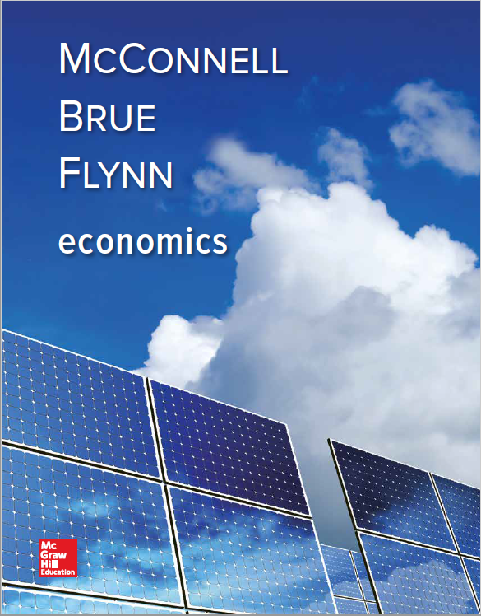
Chapter 33
Current Issues in Macro Theory and Policy
Notes:
Like any discipline, there are disagreements about how the economy really works. Economists don’t always agree, and in this chapter we will explore those different perspectives. Essentially we will focus on three main questions for which economists often have different answers. First, what causes instability in the economy? Will the economy correct itself? Also, should the government be required to follow rules when implementing policies, or should government be able to use its own discretion when determining the appropriate policy for the economy?

Slide 2
Causes of Macro Instability
Mainstream view
Held by most economists
Price stickiness
Unexpected demand shocks
Variable investment spending
Unexpected supply shocks
LO1
Notes:
The mainstream view held by most economists would tend to indicate that instability in the economy comes from two different sources: the inability of prices to change in the short run (price stickiness) and unexpected shocks to aggregate demand or short run aggregate supply. Keep in mind that the short run can be a period of several years, so it is normal to see ups and downs in that interim. A long-run perspective is looking out over at least a decade or more. If our aggregate demand changes, the most significant impact will come from changes in investment spending which are usually dictated by interest rate changes. Aggregate supply shocks could come from events such as wars, natural disasters, or some other supply restriction of a key resource.

Slide 3
Causes of Macro Instability Continued
Monetarist view
Government interference is the problem
Equation of exchange MV = PQ
Stable velocity
Monetary causes of instability
Inappropriate monetary policy
LO1
Notes:
The monetarists believe that the economy would take care of itself were it not for the interference of the government. The fundamental equation of monetarists is called the “equation of exchange” and is defined as the supply of money times the velocity at which the money is spent equal to the price level times the physical volume of all goods and services produced.
Monetarists feel that velocity, or spending, is relatively stable, which is not to say it is always the same. They feel it has trended up over the decades. Their position is that the percentage of spending versus saving compared to GDP (PV) stays consistent over time. This means that if GDP rises, spending obviously will increase but will remain the same comparative percent of GDP.
A monetarist believes that instability comes from the inappropriate use of monetary policy by the government. That is, if the government just stayed out of the way, the economy would take care of itself in the long run. Unfortunately, that usually means that in the short run there will be pain, and the government tries to avoid those short-run shocks.

Slide 4
Causes of Macro Instability Concluded
Real-business-cycle view
Shifts in long-run aggregate supply
AS_{LR2}
AS_{LR1}
Price Level
P₁
AD₁
AD₂
Q₂
Q₁
LO1
Real Domestic Output
Notes:
In the real-business-cycle view, economists take the position that business fluctuations occur from technology and resource availability. Economists feel that recessions are primarily caused by decreases in productivity from higher costs of technology and resources, shifting the long-run aggregate supply curve to the left and resulting in fewer goods being produced like in the graph. Since there are fewer goods being produced, the demand for money will fall. A new technology that increases output would shift the long run aggregate supply curve rightward causing real output to increase and the supply and demand for money to increase. The real-business-cycle view sees aggregate supply as the driving force in economic instability.

Slide 5
Coordination Failures
Fail to reach equilibrium because of lack of coordination mechanism
Limited information
Expectations and self-fulfilling prophecy
Unemployment equilibrium
Inflation equilibrium
LO1
Notes:
Coordination failures occur in the economy when people fail to act in a way that results in a mutually beneficial equilibrium. Why? Usually because they lack a way to coordinate their activities, or they are unaware of the effect of their behaviors due to limited information. If people think there are bad times ahead, they cut back on spending which reduces aggregate demand which will cause firms to cut back which, in effect, creates the bad times people were expecting!
Unemployment or inflation equilibriums are caused by differing sets of expectations. Macroeconomic instability occurs as the economy moves from one equilibrium to another as peoples’ expectations change.

Slide 6
Does the Economy Self Correct?
New classical view
Rational expectations theory
Monetarists
Automatic correction will occur
Speed of adjustment
Unanticipated price-level changes
Fully anticipated price-level changes
LO2
Notes:
Most new classical economists either tend to subscribe to the rational expectations theory or are monetarists. They feel that if the economy gets out of balance, so to speak, people will take rational actions on their own to automatically move the economy back to equilibrium. Government should stay out of the way and let nature take its course. It may take several years. In the RET view, the process may even occur faster as it assumes that people behave rationally and quickly adjust to new information, that all product and resource markets are highly competitive, and that prices and wages are flexible both upward and downward.

Slide 7
Effects of an Increase in AD
New Classical View of Self-Correction
AS_{LR}
AS₂
AS₁
P₃
c
Price Level
P₂
b
P₁
a
AD₂
AD₁
Q₁
Q₂
Real Domestic Output
LO2
Notes:
Here we see the effects of an unanticipated increase in aggregate demand, according to the new classical view. The increase first moves the economy from a to b, then the economy self-corrects itself to c as people demand higher nominal wages in response to the increase in prices.

Slide 8
Effects of a Decrease in AD
New Classical View of Self-Correction
AS_{LR}
AS₁
AS₃
Price Level
P₁
f
a
P₄
d
P₅
e
AD₁
AD₃
Q₄
Q₃
Q₁
Real Domestic Output
LO2
Notes:
In this example, we see the effects of a decline in aggregate demand, moving the economy from a to d, and then the economy self-corrects to e. Prices drop accordingly. Mainstream economists would say that due to downward wage inflexibility, the economy will move from a to f, and even if the price level falls, the economy remains at d due to those stuck wages.

Slide 9
Does the Economy Self Correct? Concluded
Mainstream view
Downward wage inflexibility
Efficiency wage theory
Greater work effort
Lower supervision costs
Reduced job turnover
Insider-outsider relationships
LO2
Notes:
The key difference between the new classical economists and mainstream economists deals with the issue of downward price and wage flexibility. Mainstream economists argue that prices and wages are downward inflexible over long periods of time, and due to that fact, it may take fiscal and monetary policy to help the economy recover quickly.
One reason firms may not be able to lower wages comes from the efficiency wage theory. This theory is based on the idea that higher wages make more efficient workers and therefore are actually more cost-effective. Another reason wages can be difficult to lower comes from insider-outsider relationships. Even though it makes sense that if there are many unemployed workers, those unemployed workers could offer to do the same work for less, many employers are reluctant to replace more expensive workers with the cheap labor. Those workers who stayed would resent the new employees, and the newly-laid off workers would foster resentment against the firm.

Slide 10
Rules or Discretion?
In support of policy rules
Reduce macro instability
Monetary rule
Shift AD to keep up with AS
Price stability achieved
Inflation targeting
Balanced budget
LO3
Notes:
Obviously there is much debate on the role of the government in the economy. Should the government try to help or “steer” the economy to avoid the ups and downs, or should it just stay out of it and let the economy take care of itself? All economists recognize the fact that the instabilities in the economy can cause people severe problems in the short run. Monetarists and new classical economists both feel that some policy rules would help to reduce instability. Monetarists support a monetary rule such as a requirement that the Fed expand the money supply each year at the same rate as the typical growth of the economy’s production capacity.
Others advocate a rule on inflation targeting which would involve the Fed announcing a target band of inflation rates for a future period and then using monetary tools to maintain the targets.
A few favor a constitutional amendment requiring a balanced budget from government to rein in the government’s ability to use fiscal policy to interfere in the economy.
Monetarists are particularly opposed to expansionary fiscal policy.

Slide 11
Monetary Rule
AS_{LR1}
AS_{LR2}
Price Level
P₁
AD₂
P₂
AD₁
Q₁
Q₂
Real Domestic Output, GDP
LO3
Notes:
This graph illustrates the effect of a monetary rule that would require the Fed to increase the money supply at an annual rate linked to the long-run increase in potential GDP. As AD shifts to the right due to the increased GDP, AS would shift at a similar rate, and thus the economy would grow without experiencing inflation or deflation.

Slide 12
Rules or Discretion? Continued
Defense of discretionary stabilization policy
Discretionary monetary policy
Velocity is not stable
Discretionary fiscal policy
Useful during recession
Policy successes
LO3
Notes:
Mainstream economists oppose both of the ideas of the monetarists and new classical economists. They feel that it should be left to the discretion of the government to decide which tools, monetary or fiscal, should be used to help stabilize the economy and achieve economic growth and full employment. They point to recent policy successes over the past 30 years to support their beliefs. Government was able to use its discretionary fiscal and monetary policies to help the economy recover from recessions and curb inflation and at the same time encourage growth.

Slide 13
Summary of Alternative Views
LO4
Notes:
Here is a summary of the differing philosophies of economists.

Slide 14
Market Monetarism
Use predictions market to adjust monetary policy
Most accurate predictions about future
Use for predicting nominal GDP
“Targeting the forecast”
Notes:
In the aftermath of the Great Recession of 2007-2008 a new monetary rule has been proposed. The suggestion is for the Fed and other central banks to use the predictions market to make decisions about adjusting monetary policy given that predictions markets have made the most accurate predictions about the future. They incorporate the knowledge and insights of everyone who participates. It is argued that the Fed should use the predictions markets for nominal GDP and then use those predictions to adjust monetary policy to work towards achieving a 5% growth in nominal GDP. The idea is that doing so would promote economic stability. At this point the debate over an optimal monetary policy rule will continue.

