Slide 1
Chapter 32
Extending the Analysis of Aggregate Supply
Notes:
We will analyze how aggregate demand and supply change as we move from the short run to the long run. We will apply this model to cost-push inflation, demand-pull inflation, and economic growth. The Phillips curve is introduced along with the impact of taxes on aggregate supply and economic growth.

Slide 2
From Short Run to Long Run
Short run
Input prices inflexible
Upsloping aggregate supply
Long run
Input prices fully flexible
Vertical aggregate supply
The transition?
LO1
Notes:
Moving from short-run aggregate supply to a long-run aggregate supply model is a key analytical tool in understanding how the economy adjusts to economic shocks as well as monetary and fiscal policy. While in the short run, input prices tend to be inflexible, meaning they cannot be changed easily. In the long run, all prices are fully flexible. Making the transition from short run to long run will provide much insight into the process.

Slide 3
From Short Run to Long Run Continued
Production above potential output:
High demand for inputs
Input prices rise
Short run aggregate supply shifts left
Return to potential output
Production below potential output
Graphical examples…
LO1
Notes:
In short run aggregate supply analysis it is necessary to make three assumptions: (1) the initial price level is P₁, (2) firms and workers have established nominal wages on the expectation that this price level will exist, and (3) the price level is flexible both upward and downward. In this model, the economy will be operating at full-employment output. If prices increase, because nominal wages and other input prices are fixed, firms receive more profits, which will lead them to increase output, which will move the economy beyond full-employment, which will reduce the unemployment rate below its natural level.
If prices fall, the opposite effect would occur. These movements occur along the short run aggregate supply line. In the long run, nominal wages can adjust in response to changes in the price level. In that situation, an increase in prices leads to an increase in input prices, which will result in the short run AS curve actually shifting upward to a new level. If prices fall, the AS curve shifts downward. These shifts allows us to derive a vertical long run AS curve located at the full-employment output level.

Slide 4
Aggregate Supply Graphs
Short-Run
Aggregate Supply
Long-Run
Aggregate Supply
AS₁
AS_{LR}
AS₂
AS₁
a₂
b₁
a₂
AS₃
P₂
P₂
Price Level
a₁
Price Level
a₁
P₁
P₁
a₃
a₃
P₃
P₃
c₁
Q₃
Q_{f}
Q₂
Q_{f}
Real Domestic Output
Real Domestic Output
LO1
Notes:
Here we see the movement along the short run AS curve in the first graph as prices increase or decrease. In the second graph, we see the short run AS curve shift up or down as prices increase or decrease and the new long run AS curve is drawn vertically at the full-employment output level, reflecting the new price levels. In the long run, all things move back to equilibrium.

Slide 5
Equilibrium in the Long-Run
Long Run Equilibrium
AS_{LR}
AS₁
Price Level
a
P₁
AD₁
Q_{f}
Real Domestic Output
LO1
Notes:
Bringing in the aggregate demand curve, we now have a graph with three curves: short run aggregate supply, long run aggregate supply, and aggregate demand (which is the same regardless of short run or long run). All three intersect at the long run outcome, which is the nation’s natural level of unemployment. In the U.S., that is assumed to be between 4-5%.

Slide 6
Extended AD-AS Model
Demand-Pull Inflation
AS_{LR}
AS₂
AS₁
P₃
c
P₂
b
Price Level
a
P₁
AD₂
AD₁
Q_{f}
Q₂
Real Domestic Output
LO2
Notes:
This graph demonstrates the effects of demand-pull inflation on the model. Demand-pull inflation occurs when an increase in aggregate demand pulls up the price level. Since the demand-pull inflation causes the aggregate demand curve to shift to the right, it causes the price level to increase, which expands output to a higher level. Since the economy is now producing above the potential output, inputs are in high demand, which in the long run causes their prices to also adjust upwards. This therefore causes the short run aggregate supply curve to shift upwards, moving equilibrium back to the long run aggregate supply curve. In the short run, demand pull inflation increases both the price level and real output, but in the long run only the price level will increase as output will always return to the full-employment level.

Slide 7
Extended AD-AS Model Continued
Cost-Push Inflation
AS_{LR}
AS₂
AS₁
P₃
c
P₂
b
Price Level
a
P₁
AD₂
AD₁
Q₂
Q_{f}
Real Domestic Output
LO2
Notes:
Under cost-push inflation, factors have arisen that have increased the cost of production at each level of production, causing the short run aggregate supply curve to shift upwards and increase the price level. Cost-push inflation typically causes inflationary pressures on the economy, and government usually will move to counter the negative effects by using fiscal and monetary policy to increase aggregate demand. This only ends up moving the prices even higher as the economy seeks to return to the natural full-employment level of output. If the government does not take action, the economy will eventually return on its own to the natural level, but the process will be painful as wide-spread business failures, layoffs, and plant closures usually follow the process. So the government ends up between a rock and a hard place: do nothing and deal with an extended recession, or take action and end up with higher inflation.

Slide 8
Extended AD-AS Model Concluded
Recession
AS_{LR}
AS₁
AS₂
P₁
a
P₂
b
Price Level
c
P₃
AD₁
AD₂
Q₁
Q_{f}
Real Domestic Output
LO2
Notes:
The most challenging issue to deal with is the effect of recession on the model. In a recession, aggregate demand declines and shifts left, which reduces prices. The economy will be producing less, so the demand for inputs will be low. Eventually nominal wages will drop. Once the wages fall, aggregate supply will decrease, which will decrease prices further. We are back at the long run equilibrium of full-employment, but at a much lower price level.

Slide 9
Extended AD-AS Model Uses
Explaining ongoing inflation
Ongoing economic growth shifts aggregate supply
Ongoing increases in money supply shift aggregate demand
Small positive rate of inflation
LO2
Notes:
In the real world, inflation is a constant. Things cost more today than 100 years ago or even 10 years ago. How can the economy still achieve a reasonable rate of growth if this happens? The answer is that the aggregate demand or the long run aggregate supply curve shifts in an on-going process.

Slide 10
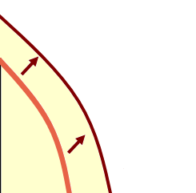
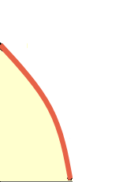
Economic Growth, Ongoing Inflation
Productions Possibilities
Long Run Aggregate Supply
AS_{LR1}
AS_{LR2}
Capital Goods
Price Level
Consumer Goods
Real GDP
Increase in production possibilities
Increase in long-run aggregate supply
LO2
Notes:
Economic growth is illustrated by either an outward shift on the production possibilities curve or a rightward shift in the long run aggregate supply curve. As the curves shift, they will lead to price increases at a new equilibrium level. Prices very rarely decrease in the long run. Why not? The Federal Reserve will increase the money supply to create rightward shifts in the aggregate demand curve.

Slide 11
U.S. Growth
U.S. Growth
ASLR1
ASLR2
AS2
AS1
P2
Price level
P1
AD2
AD1
0
Q1
Q2
Real GDP
LO2
Notes:
The key to managing inflation is for the Fed to use monetary policy to shift the aggregate demand curve to the right faster than the supply factors of economic growth shift the long-run aggregate supply curve to the right. An economy can withstand mild inflation as long as it is occurring at a slow pace. It is the sudden shifts in the curve that cause economic chaos.

Slide 12
Inflation and Unemployment
Low inflation and low unemployment rates
Fed’s major goals
Compatible or conflicting?
Short-run tradeoff
Aggregate supply shocks cause both rates to rise
No long-run tradeoff
LO3
Notes:
Is it possible to have low inflation and low unemployment at the same time? In the short run, there is a trade off: to achieve low inflation, you will have to tolerate a higher rate of unemployment. However, over the long run, it is possible to have your cake and eat it too, so to speak.

Slide 13
The Phillips Curve
AS
P₃
Price Level
P₂
AD₃
P₁
P₀
AD₂
AD₁
AD₀
0
Q₀
Q₁
Q₂
Q₃
Real Domestic Output
LO3
Notes:
This idea is apparent here as we look at the short run aggregate supply curve illustrated in this graph. Here you can see that as aggregate demand expands, in the short run the price level increases. As the price level increases, firms will increase production, which in turn will lead to higher employment. We will end up with the downward sloping Phillips curve in the next slide.

Slide 14
The Phillips Curve Continued
Demonstrates short-run tradeoff between inflation and unemployment
Concept
Empirical Data
Data for the 1960s
69
68
Annual Rate of Inflation (Percent)
Annual Rate of Inflation (Percent)
66
67
65
63
64
62
61
Unemployment Rate (Percent)
Unemployment Rate (Percent)
LO3
Notes:
The Phillips Curve, named for economist A.W. Phillips, suggests an inverse relationship between the rate of inflation and the rate of unemployment. As we see in these graphs, you end up with a downward sloping curve. Statistics from the 1960s support this concept.

Slide 15
The Phillips Curve: Supply Shocks
1960s economists believed in stable, predictable tradeoff
Phillips curve shifts over time
Adverse supply shocks 1970s
OPEC oil price shock
Stagflation
Stagflation’s demise 1980s
LO3
Notes:
During the 1970s and 1980s, the Phillips curve was put to the test. This period saw both higher inflation and higher unemployment rates, leading economists to develop the term “stagflation,” a combination of stagnation and inflation. It led to the development of a second generalization: aggregate supply shocks can cause both higher rates of inflation and higher rates of unemployment. Adverse aggregate supply shocks are sudden, large increases in resource costs that can jolt an economy’s short run aggregate supply curve leftward.
The oil crisis of the 1970s, brought about by the quadrupling of oil prices by OPEC, was a significant shock to the system. It was not until the early 1980s that the unemployment rate started to come down, and it took almost the whole decade until the last of the effects subsided. The recession of the early 80s helped to shift the aggregate supply curve back to the right. Even the recession of 2007-2009 followed the theory of the Phillips Curve with a relatively high unemployment rate but almost nonexistent inflation.

Slide 16
The Long-Run Phillips Curve
No long-run tradeoff between inflation and unemployment
Short-run Phillips curve
Role of expected inflation
Long-run vertical Phillips curve
Disinflation
LO4
Notes:
The third generalization from the Phillips Curve analysis is that there is no long-run tradeoff between inflation and unemployment, meaning you can control inflation without causing an increase in the unemployment rate. In the short run analysis, if the actual inflation rate is higher than expected, profits temporarily rise and the unemployment rate temporarily falls. But this is not a permanent situation. In the long run, workers will demand an increase in nominal wages to reflect the increased demand for workers and the higher prices they must pay. This will reduce the temporary profits, and output will decrease, returning unemployment to its natural level. This distinction between the long run Phillips Curve and the short run Phillips Curve also helps to explain disinflation, which is a reduction in the inflation rate from year to year. When the actual rate of inflation is lower than expected, profits temporarily will fall and the unemployment rate will temporarily rise until equilibrium is restored in the long run.

Slide 17
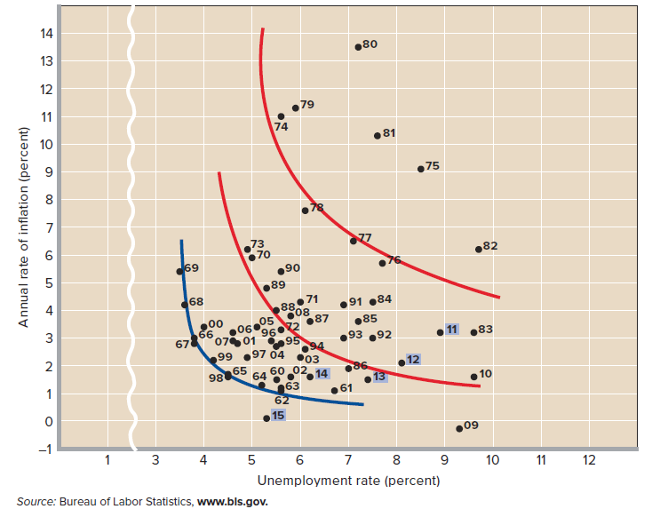
Inflation and Unemployment Rates
LO4
Notes:
This graph illustrates the impact of the supply shocks of the 1970s on inflation and unemployment. In the 1990s and 2000s, inflation eased and the curve shifted back towards the 1960s Phillips Curve. During the Great Recession of 2008-2009 the data point for 2009 shifted down and to the right dramatically. Since then data points show inflation and unemployment both falling which is inconsistent with moving along a single fixed Phillips curve.

Slide 18
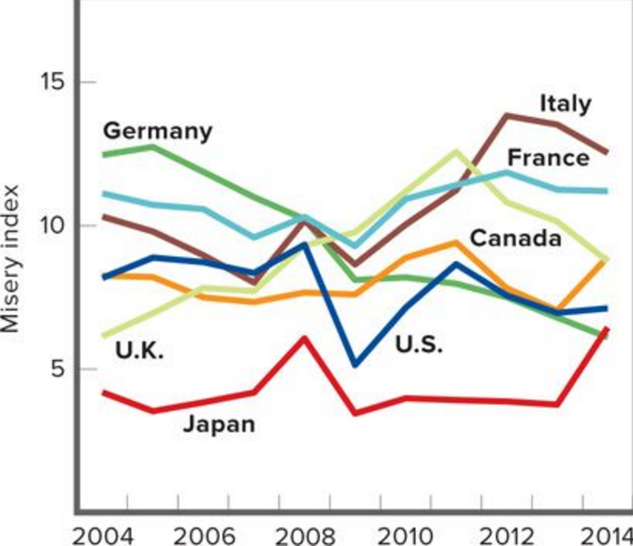
The Misery Index
LO4
Notes:
This graph measures the effect of inflation and high unemployment on a nation’s economic discomfort. Note that the U.S. is typically in the middle range.

Slide 19
The Long-Run Phillips Curve Continued
PC_{LR}
15
PC₃
12
b₃
PC₂
a₃
9
Annual Rate of Inflation (Percent)
b₂
PC₁
a₂
c₃
6
b₁
a₁
c₂
3
0
3
4
5
6
Unemployment Rate (Percent)
LO4
Notes:
This graphs helps to illustrate the movement in prices as aggregate demand increases beyond the full-employment output level. Profits may temporarily increase but increases in nominal wages will eventually increase, moving output back to the full employment level.

Slide 20
Taxes and Aggregate Supply
Supply-side economics
Tax and incentives to work
Incentives to save and invest
The Laffer curve
100
n
Laffer Curve
Tax Rate (Percent)
m
m
l
Maximum
Tax Revenue
0
LO5
Tax Revenue (Dollars)
Notes:
Supply-side economists feel that changes in aggregate supply are an active force in determining the levels of inflation, unemployment, and economic growth. They feel the government should use fiscal policy to encourage the desired economic behavior. One tool the government has in its arsenal is taxation. Taxes can be used to encourage people to work, save, and invest. Lower marginal rates can encourage workers to work longer as their after-tax wage increases and makes work more attractive. Lower marginal rates also encourage people to save and invest, as they will be able to keep more of the income from the investment. The Laffer Curve depicts the relationship between tax rates and tax revenue. It shows that there is a maximum tax rate that will maximize tax revenue. If the tax rate rises above this level, tax revenues actually decline as the higher tax rates discourage economic activity.

Slide 21
Taxes and Aggregate Supply Continued
Criticisms of the Laffer curve
Taxes, incentives, and time
Inflation or higher real interest rates
Position on the curve
Rebuttal and evaluation
LO5
Notes:
Supply-side economics is not without its critics. Some economists feel that the impact of a tax cut on incentives is too small to matter or takes too long to occur. They feel that the demand-side effects of tax cuts are more effective. In the 1980s, the Reagan administration used supply-side economics to help the economy out of a recession, but this resulted in large budget deficits. In the 1990s the Clinton administration increased the highest marginal tax rates in an attempt to pay down those deficits. In the 2000s, the Bush administration reduced the rates again to combat the recession of 2001. Overall it has been a see-saw between the two theories, but the current feeling is that the U.S. economy is operating at a point below m on the Laffer Curve in the area where an increase in tax rates should lead to an increase in tax revenue.

Slide 22
Taxes and Real GDP
New findings suggest tax increases reduce real GDP (Romer and Romer, 2008)
Positive output shocks raise tax revenues
Difficult to separate the effects of tax changes from other effects
Investment falls sharply in response to tax changes
Notes:
The Last Word article proposes the idea that tax increases actually reduce real GDP, providing support to those supply-side economists who advocate using tax cuts in an attempt to stimulate economic growth. It does support the idea, however, that increasing taxes to reduce an inherited budget deficit, such as Clinton’s in the 1990s, have much smaller output costs than other tax increases.

