Slide 1
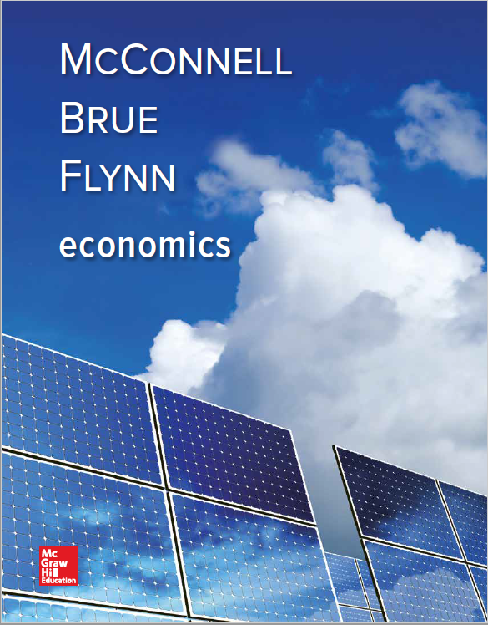
Chapter 31
Financial Economics
Notes:
This chapter addresses financial economics — investor preferences and how they affect the rating and pricing of financial assets like stocks, bonds, and real estate. Various possible financial assets will be discussed. The impact of arbitrage on asset prices and rates of return will be evaluated, along with the role of risk. Lastly, we will look at the security market line and its applications.

Slide 2
Financial Investment
Economic investment
New additions or replacements to the capital stock
Financial investment
Broader than economic investment
Buying or building an asset for financial gain
New or old asset
Financial or real asset
LO1
Notes:
In this chapter we are focusing on the broader sense of financial investments which includes buying any type of asset, regardless of whether it is new or used. Financial investments can either be financial assets such as stocks and bonds or real assets like land, buildings, or equipment. Economic investment refers to buying new additions to the capital stock or new replacements for worn-out capital stock.

Slide 3
Compound Interest
Compound interest
Earn interest on the interest
X dollars today = (1 + i)^{t}X dollars in t years
$100 today at 8% is worth:
$108 in one year
$116.64 in two years
$125.97 in three years
LO2
Notes:
Present value is one of the most useful concepts in business. Understanding the time-value of money helps to explain why keeping all of your cash in your mattress is not a good idea. The fact that future values are less than present values can help a person make the decisions needed so that they have the money required in the future to pay for events like retirement, college, or buying a house.

Slide 4
Present Value Model
Present Value of a future amount of money
Calculate what you should pay for an asset today
Asset yields future payments
Asset’s price should equal total present value of future payments
The formula:
X
dollars today = X dollars in t years
( 1 + i)^{t}
LO2
Notes:
The key to calculating the present value of an asset is to understand the asset’s future payments, that is what you will receive in the future from the asset. In addition, you also must know the interest that is expected in the future and how far into the future the payments will be received.

Slide 5
Applications
Take the money and run
Lottery jackpot paid over a number of years
Calculating the lump sum value
Salary caps and deferred compensation
Calculating the value of deferred salary payments
LO2
Notes:
Understanding present value is useful for many decisions. Say you finally hit the Megajackpot in the lottery and have to make a decision about taking a lump sum payment up front, or receiving annual payments over a number of years. Which is the better option? It all depends on your preferences because in the long run you will end up with the same amount of money. It is also why, for example, no single professional sports team will have all of the top players as they are subject to salary caps and deferred compensation arrangements that even out the playing field.

Slide 6
Popular Investments
Wide variety available to investors
Three features
Must pay to acquire
Chance to receive future payment
Some risk in future payments
LO3
Notes:
To some extent, investments sound a lot like most gambling arrangements in that you must pay to play and there is a chance you will receive money in the future, but the amount and likelihood of the future payments is questionable. Investments typically are just a little more secure and the probabilities are higher than your state lottery.

Slide 7
Stocks
Represents ownership in a company
Bankruptcy possible
Limited liability rule
Capital gains
Dividends
LO3
Notes:
Investing in stocks is one option. Stocks represent ownership shares in a company or equity. There is a risk that if the company fails, the investor will lose his investment. One key advantage to owning stock is that it provides the owners with what’s called limited liability, meaning the most they can lose is the amount they paid for their stock. Creditors cannot come after the owners if the company goes bankrupt owing more than the value of the assets. Owners also get to share in the financial gains of the firm. When the business makes money, it will distribute some of the earnings to the owners through dividends. Owners also make money through capital gains. As the value of the business increases, the value of the owners’ shares increases and they are able to sell their shares for more than they paid.

Slide 8
Bonds
Debt contracts issued by government and corporations
Possibility of default
Investor receives interest
LO3
Notes:
Bonds are considered debt securities and are traded the same as stocks. A key difference between stocks and bonds is that bonds are more predictable. The future payments are fixed as to the amount and time. The default risk depends on the type of bond. Bonds issued by governments are much safer as the likelihood the government will fail is remote. With corporations, the default risk depends on the health of the company. All bond issuances are rated for risk by the varying rating agencies such as Moody’s or Standard & Poor’s. Bond prices are inversely related to interest rates. As interest rates rise, bond prices go down and vice versa. They typically have a lower average rate of return than stocks because they are less risky.

Slide 9
Mutual Funds
Company that maintains a portfolio of either stocks or bonds
Currently more than 8,000 mutual funds
Index funds
Actively managed funds
Passively managed funds
LO3
Notes:
Mutual funds are very popular because they help to distribute investor risk. Mutual funds can tailor the portfolio to satisfy the desires of the investors. Index funds are designed so that their portfolios exactly match a specific stock or bond index, which is something that follows the performance of a particular group of stocks or bonds. Actively managed funds have portfolio managers who constantly buy and sell assets in an attempt to generate high returns, whereas passively managed funds have assets tied to the underlying index that the fund follows.

Slide 10
Mutual Funds Continued
The 10 Largest Mutual Funds, April 2016
* The letter A indicates funds that have sales commissions and are generally purchased by individuals through their financial advisors.
Source: Lipper Performance Report, March 31, 2016
LO3
Notes:
This table highlights the 10 largest mutual funds in the country as of April 2016. Note that this list is subject to change as market conditions change.

Slide 11
Calculating Investment Returns
Gain or loss stated as percentage rate of return
Difference between selling price and purchase price divided by purchase price
Future series of payments also considered into return
Rate of return inversely related to price
LO4
Notes:
The rate of return is calculated by subtracting the amount paid for an asset from the amount for which the asset is sold and then dividing the difference by the amount paid. The higher the price paid for the asset, the lower the rate of return will be. This is especially apparent in situations where there is a fixed future payment flow such as for bonds.

Slide 12
Arbitrage
Buying and selling process to equalize average expected returns
Sell asset with low return and buy asset with higher return at same time
Both assets will eventually have same rate of return
LO5
Notes:
Arbitrage is the process by which profit-motivated investors buy and sell assets in an attempt to equalize the average expected rates of return on similar assets. By going through this process, the investor is able to minimize the risk involved and the process will bring both assets into equilibrium where the returns are the same. This process allows investors to invest with confidence and therefore enables the market to function in an efficient manner.

Slide 13
Risk
Future payments are uncertain
Diversification
Diversifiable risk
Specific to a given investment
Nondiversifiable risk
Business cycle effects
Comparing risky investments
Average expected rate of return
Beta
LO6
Notes:
Investing is much like gambling. In the world of investing, the risk simply refers to the idea that an outcome lacks total certainty. The outcome could be good or bad, you just don’t know. How much risk an individual is able to handle is a personal choice. Some investors enjoy the excitement that comes with a lot of risk and others prefer to take the safe route. One way to minimize risk is to diversify, which is a strategy of investing in a large number of investments to reduce the overall risk to the entire portfolio. The old adage “don’t put all your eggs in one basket” still holds up today.
Even with diversification there will always be risk involved in investing. Nondiversifiable risk cannot be eliminated. The business cycle is an example of nondiversifiable risk. There is no way to diversify away the risk that the entire economy may collapse. Investors typically use the average expected rate of return or beta to evaluate risk. The average expected rate of return is the probability weighted average of the investment’s possible future rates of return. While this can provide investors with the information on the rate, it does not address the risk of actually earning that rate. That can be measured by what is called beta. Beta is a relative measure of nondiversifiable risk. It compares the risk of a given asset with that of a market portfolio, which contains every asset available in the financial markets.

Slide 14
Risk Continued
Risk and average expected rates of return
Positively related
The risk-free rate of return
Short-term U.S. government bonds
Greater than zero
Time preference
Risk-free interest rate
LO6
Notes:
“There is no such thing as a free lunch.” This quote is frequently used in economics and it applies to investing as well. Risk levels and average expected rates of return are positively related, meaning the higher the expected rate of return the higher the risk involved. This relationship applies to all types of assets. There are very few totally risk-free investments. The only investment considered to be risk-free is a short-term U.S. government bond. These bonds are short-term loans to the U.S. government with terms ranging from 4 to 26 weeks. The only way they would not be repaid would be if the U.S. government collapsed, which, in the short-term, is not very likely. Since these are risk-free, they typically pay a low rate of interest mainly just to compensate for the time preference.

Slide 15
Investment Risks
LO7
Notes:
The International Country Risk Guide is a monthly publication that attempts to distill the political, economic, and financial risks facing 140 countries into a single rating. The higher the rating, the less risk and more safety. This chart shows the three safest, three riskiest and a few in between as of January 2016.

Slide 16
The Security Market Line
Compensate investors for:
Time preference
Nondiversifiable risk
Average expected
rate of return
Rate that compensates
for time preference
Rate that compensates
for risk
=
+
Average expected
rate of return
=
+
i^{f}
risk premium
LO8
Notes:
The Security Market Line indicates how compensation for time preference, as well as for the amount of nondiversifiable risk, is calculated. It makes a basic assumption that any investment’s average expected rate of return should be equal to the sum of the compensation for the time preference and risk.

Slide 17
The Security Market Line Graph
Security Market
Line
Market
Portfolio
A Risk-free Asset
(i.e., a short-term U.S.
Government bond)
Risk Premium for
The Market Portfolio’s
Risk Level of beta = 1.0
Average expected rate of return
i^{f}
Compensation
For Time Preference
Equals i^{f}
0
1.0
Risk Level (beta)
LO8
Notes:
The Security Market Line slopes upward because investors must be compensated for higher levels of risk with higher average expected rates of return. For a market portfolio, the beta is 1 by definition. The exact location of the intercept is determined by the Federal Reserve’s monetary policy and how it affects the rate of return on short-term U.S. government bonds. The slope of the line is determined by investors’ feelings about risk.

Slide 18
The Security Market Line Cont’d
Risk levels determine average expected rates of return
Security Market
Line
Y
Average expected rate of return
Risk Premium for
This Asset’s Risk
Level of beta = X
i^{f}
Compensation
For Time-Preference
Equals i^{f}
0
X
LO8
Risk Level (beta)
Notes:
The average expected rate of return will compensate investors for the time preference in addition to this asset’s risk level of beta to yield a return of Y percent per year.

Slide 19
Arbitrage and The Security Market Line
A
Security Market
Line
Y
B
Average expected rate of return
f
C
0
X
Risk Level (beta)
LO8
Notes:
Arbitrage can ensure that all investments having an identical level of risk will also have identical rates of return. This graph shows that assets A, B, and C all share the same risk level in beta. Even though A and C initially have different rates of returns, arbitrage pressures will quickly eliminate these differences. With A, since the return is so high, investors will rush to purchase it and drive up its price which will drive down the average expected rate of return. With C, the opposite will occur. Equilibrium will quickly be restored.

Slide 20
The Security Market Line Concluded
An increase in the risk-free rate
SML ₂
Y₂
SML ₁
A _{After Increase}
Average expected rate of return
Y₂
f₂
Y₁
A _{Before Increase}
Y₁
f₁
0
X
Risk Level (beta)
LO8
Notes:
An increase in the risk-free rate of return by the Fed will cause the SML to shift upwards. Since the risk-free rate determines where the SML intercepts the y-axis, it will affect both average expected rates of return and asset prices.

Slide 21
SML: Applications
Fed’s expansionary monetary policy led to lower interest rates
SML shifted downward
Slope of SML increased due to increased investor risk-aversion
Stocks fell
LO8
Notes:
The actions during the recent recessionary period illustrate that investor behavior cannot always be predicted. Usually during periods of lower interest rates, the stock market rises as investors move into the market looking for higher returns. In this case, the investors became fearful about losses from investments in general and began to seek more secure investments. The increase in the slope of the SML overcame the decline in the risk-free rate of interest leading to a falling stock market.

Slide 22
Index Funds versus Actively Managed Funds
Choice of actively or passively managed mutual funds
After costs, index funds outperform actively managed by 1% per year
Role of arbitrage
Management costs are significant
Index funds are boring — no chance to exceed average rates of return
Notes:
In the long run, there is no way to beat the market and index funds are an example of that fact. Index funds, which are tied to indexes of specific stocks, consistently out-perform actively managed funds in which the assets are individually selected by a fund manager. In addition to not performing as well, actively managed funds usually have higher fees since the manager must be paid and there are transaction costs for the trading that the managers engage in to achieve the desired return. If this is the case, why do investors still use actively managed funds? It is probably the same reason people buy lottery tickets, knowing the odds of winning are astronomical. There is always a chance and hope that yours will be the exception.

