Slide 1
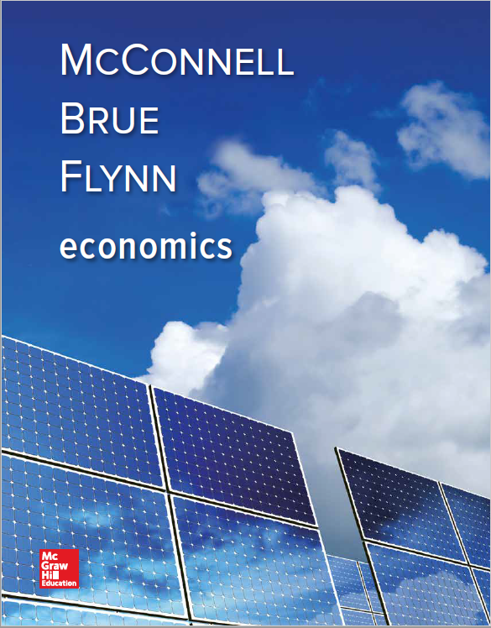
Chapter 30
Interest Rates and Monetary Policy
Notes:
This chapter starts by introducing the transactions and asset demand for money and explaining how the interaction of the demand and supply of money determine the interest rates in the market. Banks’ balance sheets are used to explain how open market operations is effective in changing the money supply. We will learn about tools other than open market operations that the Fed might use to manipulate the money supply and the reasons that these tools are chosen, or not chosen. We will then evaluate expansionary and restrictive monetary policy, conditions under which these policies should be used, and how they impact interest rates, investment, and aggregate demand. We close with a discussion of issues related to monetary policy and current monetary policy.

Slide 2
Interest Rates
The price paid for the use of money
Many different interest rates
Speak as if only one interest rate
Determined by the money supply and money demand
LO1
Notes:
Understanding interest rates is a key economic concept. For example, imagine a gentleman who was beginning a new career working for an investment firm. He did not have a business background, but he was a salesman. One evening as he was discussing his new career with an economist friend, he told his friend that the reason his firm could offer investors a much higher return than the banks was because his firm had been around for over 100 years and, therefore, was considered “safer” than a bank and did not have to purchase insurance to safeguard depositors’ funds like banks did. The economist stopped him and had to explain to him that actually it was the opposite: his firm had to pay a higher interest rate to investors to compensate the investors for their increased risk with his firm because their investments were not insured.

Slide 3
Demand for Money
Why hold money?
Transactions demand, D_{t}
Determined by nominal GDP
Independent of the interest rate
Asset demand, D_{a}
Money as a store of value
Varies inversely with the interest rate
Total money demand, D_{m}
LO1
Notes:
People hold money for many different reasons. One reason is that it is convenient to have money available to purchase necessary goods and services. This is referred to as the transactions demand, or D_{t}. The larger the value of all goods and services exchanged in the economy, the larger the amount of money that will be needed to handle all of the transactions.
The second reason for holding money is the asset demand or D_{a}. People like to hold some of their financial assets as money because money is the most liquid of all financial assets. If an emergency arises where you need funds in a hurry, you will have access to those funds quickly.
The disadvantage to holding money as an asset is that it is a non-productive asset. If you bury a pile of money in the backyard, when you dig it up ten years later, it will be the same amount that you buried, and ten years later the purchasing power of the money has probably declined.
The amount of money demanded as an asset is inversely related to the interest rates, meaning as interest rates go up, the demand for money as an asset goes down and vice versa.

Slide 4
Demand for Money Continued
(c)
Total
demand for
money, D_{m}
and supply
(a)
Transactions
demand for
money, D_{t}
(b)
Asset
demand for
money, D_{a}
10
7.5
5
2.5
0
S_{m}
Rate of interest, i percent
+
=
5
D_{t}
D_{a}
D_{m}
50
100
150
200
50
100
150
200
50
100
150
200
250
300
Amount of money
demanded
(billions of dollars)
Amount of money
demanded
(billions of dollars)
Amount of money
demanded and supplied
(billions of dollars)
LO1
Notes:
The total demand for money is the sum of the transactions demand for money plus the asset demand for money. The transactions demand for money is assumed to be vertical as it depends on GDP rather than the interest rate. The asset demand for money is inversely related to the interest rate, meaning as interest rates go up, the amount of money demanded goes down. When we introduce the supply of money into the graphs, we find an equilibrium point for money.

Slide 5
Interest Rates Continued
Equilibrium interest rate
Changes with shifts in money supply and money demand
Interest rates and bond prices
Inversely related
Bond pays fixed annual interest payment
Lower bond price will raise the interest rate
LO1
Notes:
Just like in other resource markets, there is an equilibrium interest rate that will cause the supply of money available to equal the demand for money. This rate can be thought of as the market-determined price that borrowers must pay for using someone else’s money over some period of time.

Slide 6
Federal Reserve Balance Sheet
Assets
Securities
Loans to commercial banks
Liabilities
Reserves of commercial banks
Treasury deposits
Federal Reserve Notes outstanding
LO2
Notes:
Just like any other organization, the Federal Reserve Bank’s balance sheet reports the assets and liabilities of the organization as of that point in time. The Fed’s balance sheet helps us to consider how the Fed conducts monetary policy. Securities consist of bonds that have been purchased by the Federal Reserve Banks, the majority of which are Treasury bills, notes and bonds.

Slide 7
Federal Reserve Balance Sheet Example
April 6, 2016 (in Millions)
Assets Liabilities and Net Worth
Securities
Loans to Commercial
Banks
All Other Assets
Total
$4,243,689
37
240,343
$4,484,069
Reserves of Commercial
Banks
Treasury Deposits
Federal Reserve Notes
(Outstanding)
All Other Liabilities and
Net Worth
Total
$2,467,091
263,537
1,400,041
353,400
$4,484,069
Source: Federal Reserve Statistical Release, H.4.1, April 6,2016, www.federalreserve.gov
LO2
Notes:
The two main assets of the Federal Reserve Banks are securities and loans to commercial banks. The securities are government bonds that have been purchased by the Federal Reserve Bank to increase the supply of money in the economy. Loans to commercial banks also help the banks to increase their reserves. The liabilities of the Federal Reserve Banks have three noteworthy items. The reserves of commercial banks represent the required reserves that banks must hold to ensure their stability. These reserves are also listed as assets on the banks’ books. The Treasury Deposits represent the amount of money the U.S. government has on deposit with the Fed. The government uses this money to pay its obligations. The Federal Reserve Notes Outstanding represents the supply of paper money currently circulating outside of the Federal Reserve Banks. Over the past couple of years, the balance sheet of the Fed has increased dramatically as the Fed has taken various actions to help the economy recover from the recession.

Slide 8
Central Banks
LO2
Notes:
This chart contains some examples of the central banks of other nations. Like the Federal Reserve System, these banks coordinate the monetary policies of their countries.

Slide 9
Four Tools of Monetary Policy
Open Market Operations
The Reserve Ratio
The Discount Rate
Interest on Reserves
LO3

Slide 10
Tool #1: Open-Market Operations
Open-market operations
Buying and selling of government securities (or bonds)
Commercial banks and the general public
Used to influence the money supply
When the Fed sells securities, commercial bank reserves are reduced
LO3
Notes:
Open market operations are used by the Fed to increase or decrease the commercial bank reserves available which, in turn, will affect the amount of money available in the economy. This process has expanded since the mortgage debt crisis of 2008.

Slide 11
Open-Market Operations: Fed Buys Bonds from Commercial Banks
Federal Reserve Banks
Assets
Liabilities and Net Worth
+ Securities
+ Reserves of Commercial Banks
(a) Securities
(b) Reserves
Commercial Banks
Assets
Liabilities and Net Worth
Securities (a)
+Reserves (b)
LO3
Notes:
As part of their open-market operations, the Fed will buy or sell government bonds. If they purchase the bonds from commercial banks, the commercial banks are in effect transferring part of their holding of securities to the Fed, which creates new reserves for the banks in their accounts at the Fed. By increasing the commercial banks’ reserves, the Fed has increased their lending capacity.

Slide 12
Open Market Operations: Fed Buys Bonds from Commercial Banks Continued
Fed buys $1,000 bond from a commercial bank
New Reserves
$1000
Excess
Reserves
$5000
Bank System Lending
Total Increase in the Money Supply, ($5,000)
LO3
Notes:
When the Fed buys government bonds from commercial banks, it increases the assets of the Fed and increases the reserves of the commercial banks. This will increase the lending ability of the commercial banks.

Slide 13
Open Market Operations: Fed Buys Bonds from the Public
Fed buys $1,000 bond from the public
Check is Deposited
New Reserves
$1000
$800
Excess
Reserves
$200
Required
Reserves
$4000
Bank System Lending
$1000
Initial
Checkable
Deposit
Total Increase in the Money Supply, ($5000)
LO3
Notes:
When the Fed buys government bonds from the public, the effect is much the same. The assets of the Fed increase, and as the public deposits the funds into a commercial bank, its reserves and lending ability will increase.

Slide 14
Open Market Operations: Fed Sells Bonds to Commercial Banks
Fed sells bonds to commercial banks
Federal Reserve Banks
Assets
Liabilities and Net Worth
- Securities
- Reserves of Commercial Banks
(a) Securities
(b) Reserves
Commercial Banks
Assets
Liabilities and Net Worth
+ Securities (a)
- Reserves (b)
LO3
Notes:
If the Fed sells government bonds to commercial banks, the opposite effect occurs. The banks lose reserves, which will reduce their lending capacity.

Slide 15
Open Market Operations: Fed Sells Bonds to the Public
Same effect as selling bonds to commercial banks
LO3
Notes:
Whether the Fed sells bonds to the public or to commercial banks, the result is the same. When the Federal Reserve Banks sell securities on the open market, commercial bank reserves are reduced. If all excess reserves are already lent out, this decline in commercial bank reserves produces a decline in the nation’s money supply.

Slide 16
Repos and Reverse Repos
Collateralized loans
Repo transaction — loan of money in exchange for government bonds used as collateral
Reverse repo — repo in reverse
LO3
Notes:
By using repos and reverse repos, the Fed can also manipulate the money supply. When it makes repo transactions the money supply is increased and reverse repos decrease the money supply.

Slide 17
Tool #2: The Reserve Ratio
Changes the money multiplier
The discount rate
The Fed as lender of last resort
Short term loans
Term auction facility
Introduced December 2007
Banks bid for the right to borrow reserves
LO3
Notes:
In addition to open market operations, the Fed has three other tools available. The Fed can change the reserve ratio, which will affect the ability of commercial banks to lend. If the reserve ratio is increased, the money multiplier will decrease and vice versa.
As the “lender of last resort,” the Fed makes short-term loans to banks to cover unexpected and immediate needs for additional funds. The rate that the Fed charges the banks is called the discount rate. In providing the loan, the Fed increases the reserves of the borrowing bank. Since there are no required reserves against loans from the Fed, all new reserves are considered excess reserves, and as such, they enhance the ability of the bank to lend. If the Fed raises the discount rate, it discourages banks from borrowing, and if it lowers the rate, it encourages banks to borrow.
The term auction facility is another way that the Fed can alter bank reserves. Twice a month, the Fed auctions off the right for banks to borrow reserves for 28- and 84-day periods. This tool allows the Fed to guarantee that the amount of reverses it wishes to lend will be borrowed and, therefore, will be available as excess reserves in the banking system to increase lending.

Slide 18
The Reserve Ratio Continued
Effects of Changes in the Reserve Ratio
(1) Reserve Ratio, % | (2) Checkable Deposits | (3) Actual Reserves | (4) Required Reserves | (5) Excess Reserves, (3) - (4) | (6) Money-Creating Potential of Single Bank, = (5) | (7) Money-Creating Potential of Banking System
(1) 10 | $20,000 | $5000 | $2000 | $3000 | $3000 | $30,000
(2) 20 | 20,000 | 5000 | 4000 | 1000 | 1000 | 5000
(3) 25 | 20,000 | 5000 | 5000 | 0 | 0 | 0
(4) 30 | 20,000 | 5000 | 6000 | -1000 | -1000 | -3333
LO3
Notes:
This table shows that a change in the reserve ratio affects the money-creating ability of the banking system as a whole in two ways, (1) by changing the amount of excess reserves, and (2) changing the size of the monetary multiplier.

Slide 19
Tool #3: The Discount Rate
The discount rate
The Fed as lender of last resort
Short term loans
LO3
Notes:
As the “lender of last resort,” the Fed makes short-term loans to banks to cover unexpected and immediate needs for additional funds. The rate that the Fed charges the banks is called the discount rate. In providing the loan, the Fed increases the reserves of the borrowing bank. Since there are no required reserves against loans from the Fed, all new reserves are considered excess reserves, and as such, they enhance the ability of the bank to lend. If the Fed raises the discount rate, it discourages banks from borrowing, and if it lowers the rate, it encourages banks to borrow.
The term auction facility is another way that the Fed can alter bank reserves. Twice a month, the Fed auctions off the right for banks to borrow reserves for 28- and 84-day periods. This tool allows the Fed to guarantee that the amount of reverses it wishes to lend will be borrowed and, therefore, will be available as excess reserves in the banking system to increase lending.

Slide 20
Tool #4: Interest on Reserves
Law changed in 2008
Allows banks to pay interest on excess reserves
Can encourage or discourage banks to keep reserves
LO3
Notes:
In 2008, federal law was changed so that the Federal Reserve could for the first time pay banks interest on excess reserves. By changing the interest rate the Federal Reserve can encourage or discourage banks to keep reserves, thereby influencing the amount of lending banks do.

Slide 21
Tools of Monetary Policy Summary
Open market operations are the most important
Reserve ratio last changed in 1992
Discount rate was a passive tool
Interest on reserves
LO3
Notes:
The open market operations are the most important tool in the Fed’s arsenal. It gives the Fed great flexibility in controlling the money supply, and the impact on the money supply is swift. The other tools are typically only used in special circumstances. For example, the last change in the reserve ratio came in 1992 and was done more to shore up banks and thrifts in the aftermath of the 1990-1991 recession than to impact the money supply. In 2008, federal law was changed so that the Federal Reserve could for the first time pay banks interest on excess reserves. By changing the interest rate the Federal Reserve can encourage or discourage banks to keep reserves, thereby influencing the amount of lending banks do.

Slide 22
The Federal Funds Rate
Rate charged by banks on overnight loans
Targeted by the Federal Reserve
FOMC conducts open market operations to achieve the target
Demand curve for Federal funds
Supply curve for Federal funds
LO4
Notes:
Instead of leaving excess reserves at the Federal Reserve Banks, which typically pay less interest than commercial banks, when banks have excess reserves, they will prefer to loan them to other banks that temporarily need the money to meet their own reserve requirements. The rate charged by the commercial banks on these overnight loans is referred to as the federal funds rate. It serves as the equilibrium rate for this market of bank reserves. The Federal Reserve targets this rate by manipulating the supply of reserves that are offered in the market. Typically this is done by buying or selling government bonds. The FOMC meets regularly to choose a desired federal funds rate and then directs the Federal Reserve Bank of New York to undertake the open market operations needed to achieve that rate.

Slide 23
Expansionary Monetary Policy
Economy faces a recession
Lower target for Federal funds rate
Fed buys securities
Expanded money supply
Downward pressure on other interest rates
LO4
Notes:
During times of recession and unemployment, as in the past couple of years, the Fed will initiate expansionary monetary policy. The idea is to increase the supply of money in the economy in order to increase borrowing and spending. One of the problems with the recovery today is that while spending has increased some, borrowing is actually down. It seems ironic that when people save instead of borrow, it can actually be detrimental to the economy

Slide 24
Restrictive Monetary Policy
Periods of rising inflation
Increases Federal funds rate
Decreases money supply
Increases other interest rates
LO4
Notes:
During times of rising inflation, the Fed will switch to a more restrictive monetary policy. In order to keep prices down, the Fed will increase the interest rate in order to reduce borrowing and spending, which will hopefully slow the expansion of aggregate demand that is driving up the price levels.

Slide 25
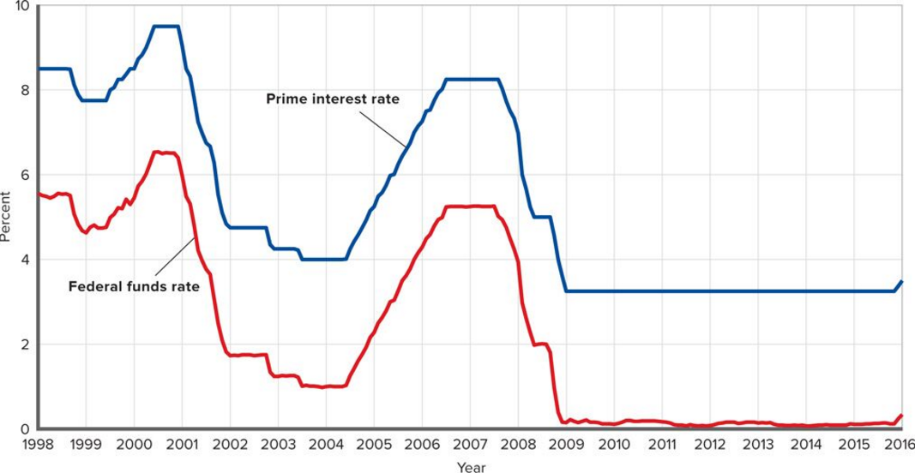
Prime Interest Rate and Federal Funds Rate
Monetary Policy
LO4
Notes:
This figure illustrates the changes in the prime interest rate and the Federal funds rate in the United States between 1998-2016. The two rates move together.

Slide 26
Taylor Rule
Rule of thumb for tracking actual monetary policy
Fed has 2% target inflation rate
If real GDP = potential GDP and inflation is 2%, then targeted Federal funds rate is 4%
Target varies as inflation and real GDP vary
LO4
Notes:
The Taylor rule was developed by economist John Taylor and builds upon the theory that central banks are willing to tolerate a small positive inflation rate if doing so helps the economy achieve its potential output. The Taylor Rule assumes that the Fed has a 2% target inflation rate and follows three basic rules when setting its target for the Federal funds rate: (1) When real GDP = potential GDP and inflation is at the target rate of 2%, the Federal funds rate should be 4%. (2) For each 1% increase of real GDP above potential GDP, the Fed should raise the real Federal funds rate by ½%. (3) For each 1% increase in the inflation rate above the 2% target rate, the Fed should raise the real Federal funds rate by ½%.

Slide 27
Monetary Policy, Real GDP, Price Level
Affect on real GDP and price level
Cause-effect chain
Market for money
Investment and the interest rate
Investment and aggregate demand
Real GDP and prices
Expansionary monetary policy
Restrictive monetary policy
LO5
Notes:
This next section will discuss how monetary policy affects the economy’s levels of investment, aggregate demand, real GDP, and prices.

Slide 28
Monetary Policy and Equilibrium GDP
(c)
Equilibrium real
GDP and the
Price level
(a)
The market
for money
(b)
Investment
demand
S_{m1}
S_{m2}
S_{m3}
AS
10
8
6
0
P₃
AD₃
I=$25
Rate of Interest, i (Percent)
P₂
Price Level
D_{m}
AD₂
I=$20
ID
AD₁
I=$15
$125
$150
$175
$15
$20
$25
Q₁
Q_{f}
Q₃
Amount of money
demanded and
supplied
(billions of dollars)
Amount of investment
(billions of dollars)
Real GDP
(billions of dollars)
LO5
Notes:
An expansionary monetary policy that shifts the money supply curve rightward in (a) lowers the interest rate from 10% to 8% which results in the investment spending in (b) to increase from $15 to $20 billion and causes aggregate demand to increase. This shifts the aggregate demand curve rightward from AD1 to AD2 in (c) so that real output rises to the full employment level Qf along the horizontal dashed line. Conversely, a restrictive monetary policy will cause the money supply curve to shift leftward, thereby increasing the interest rate, decreasing investment and aggregate demand.

Slide 29
Monetary Policy and Equilibrium GDP Continued
(c)
Equilibrium real
GDP and the
Price level
(d)
Equilibrium real
GDP and the
Price level
AS
AS
P₃
P₃
c
b
a
AD₃
I=$25
AD₃
I=$25
P₂
P₂
AD₄
I=$22.5
Price Level
Price Level
AD₂
I=$20
AD₂
I=$20
AD₁
I=$15
AD₁
I=$15
Q₁
Q_{f}
Q₃
Q₁
Q_{f}
Q₃
Real GDP
(billions of dollars)
Real GDP
(billions of dollars)
LO5
Notes:
In (d), the economy at point a has an inflationary output gap because it is producing above potential output.

Slide 30
Expansionary Monetary Policy Effects
Problem: Unemployment and Recession
CAUSE-EFFECT CHAIN
Fed buys bonds, lowers reserve ratio, lowers the discount rate, or lowers interest on reserves
Excess reserves increase
Federal funds rate falls
Money supply rises
Interest rate falls
Investment spending increases
Aggregate demand increases
Real GDP rises
LO5
Notes:
This chain illustrates the causes and effects of expansionary monetary policy. When faced with the problems of unemployment and recession, the Fed takes actions to increase the money supply, which should eventually lead to real GDP rising. Unfortunately, it is not an immediate reaction so the Fed may overshoot the mark, which can lead to inflation.

Slide 31
Restrictive Monetary Policy Effects
Problem: Inflation
CAUSE-EFFECT CHAIN
Fed sells bonds, increases reserve ratio, increases the discount rate, or raises interest on reserves
Excess reserves decrease
Federal funds rate rises
Money supply falls
Interest rate rises
Investment spending decreases
Aggregate demand decreases
Inflation declines
LO5
Notes:
In times of inflation, the Fed practices restrictive monetary policy and decreases the supply of money, which should lead to a decrease in the inflation rate. However, because prices tend to be inflexible, if the Fed is not careful, their actions can lead to a recession.

Slide 32
Evaluation and Issues
Advantages over fiscal policy
Speed and flexibility
Isolation from political pressure
Monetary policy is more subtle than fiscal policy
LO6
Notes:
Compared to fiscal policy, which involves the government changing its taxing and spending policies, monetary policy has several advantages. It can quickly be changed to fit the current economic conditions, and because the members of the Fed’s Board of Governors serve fixed terms and are appointed, not elected, they are not subject to the political pressures that elected officials are subjected to.

Slide 33
Recent U.S. Monetary Policy
Highly active in recent decades
Responded with quick and innovative actions during the recent financial crisis and the severe recession
Critics contend the Fed contributed to the crisis by keeping the Federal funds rate too low for too long
LO6
Notes:
Given the fact that the recession was declared to have officially ended in June of 2009, many economists will continue to debate whether the Fed’s actions helped or hindered the recovery. Over the past decade, the Fed has acted quickly to attempt to stimulate the economy, even lowering the Federal funds rate to almost zero.

Slide 34
After the Great Recession
Slow recovery especially in terms of employment
Zero interest rate policy
Zero lower bound problem
Quantitative easing
Forward commitment
Operation Twist
LO6
Notes:
To help stimulate the economy after the Great Recession, the Fed implemented the zero interest rate policy, quantitative easing, Operation Twist and forward guidance. Under the zero interest policy, the Fed aimed to keep short-term interest rates near zero to stimulate the economy. When growth remained weak the Fed had to find a way to deal with the zero lower bound policy under which a central bank is constrained in its ability to stimulate the economy through lower interest rates since you cannot have a negative interest rate. Their next response was quantitative easing which is similar to open-market operations but is not intended to lower interest rates but rather stimulate increased lending. In the second round the Fed engaged in forward commitment, preannouncing exactly how much it was going to buy. This continued until the Maturity Extension Program, better known as Operation Twist, was introduced in September 2011. This program was designed to reduce long-term interest rates.

Slide 35
Problems and Complications
Lags
Recognition and operational
Cyclical asymmetry
Liquidity trap
LO6
Notes:
The lags complicate monetary policy because although its impact is faster than fiscal policy, there is still a three to six month delay that can cause problems and end up with the Fed overshooting its targets. Economists also feel that monetary policy is more effective dealing with slowing expansions and controlling inflation than it is with helping the economy recover from a severe recession. Even though the Fed may create excess reserves during periods of recession, that does not mean the banks will loan the money out. This is why in the recent recessionary period, the U.S. turned more towards the use of fiscal policy to attempt to spend its way out of the recession. Which policies actually succeeded we will probably never figure out.

Slide 36
The Big Picture
Input
Resources
With Prices
Consumption
(C_{a})
Investment
(I_{g})
Productivity
Sources
Aggregate
Supply
Levels of
Output,
Employment,
Income, and
Prices
Aggregate
Demand
Net Export
Spending
(X_{n})
Legal-
Institutional
Environment
Government
Spending
(G)
LO6
Notes:
This figure illustrates the many concepts and principles discussed in the preceding chapters and how they relate to one another.

Slide 37
Less than Zero
European Central Bank set negative interest rates
Idea is to make banks lend more
Existence of a negative lower bound
Notes:
While the Fed in 2016 has planned on raising short-term interest rates there is concern that doing so might derail the already fragile recovery. Instead, the Fed could consider another round of quantitative easing. Many economists, however, might prefer the Fed follow the path of the European Central Bank and set negative interest rates. They did so in an attempt to force banks to lend more which actually did work. In some countries, people were actually being paid to borrow money which in turn was being spent and stimulating economic activity. Speculation began to focus on a “negative lower bound”, an interest rate beyond which any further cuts would be counterproductive and fail to stimulate the economy. Time will only tell which path is more successful.

