Slide 1
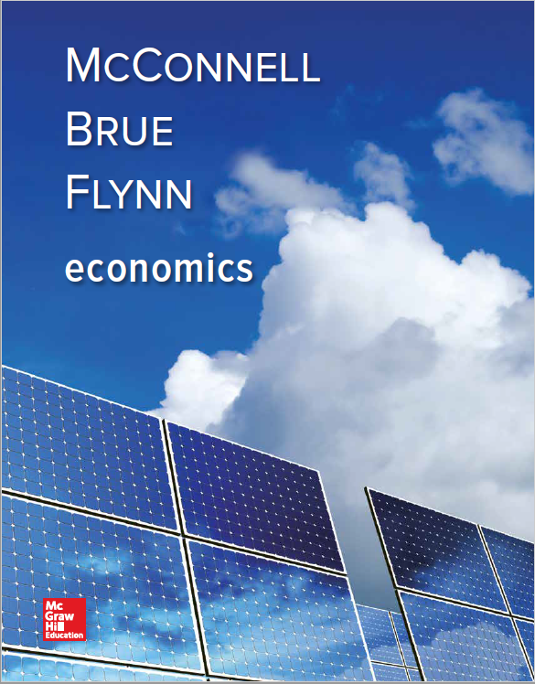
Chapter 29
Money Creation
Notes:
This chapter explains how the banking system creates money and increases the money supply. The balance sheets of the banks are used to show how different transactions impact the banks and the money supply. You will learn the difference between excess and required reserves. You will learn how the money multiplier impacts the money supply. Lastly, we will discuss the bank panics of the 1930s.

Slide 2
Fractional Reserve System
The Goldsmiths
  Stored gold and gave a receipt
  Receipts used as money by public
  Made loans by issuing receipts
Characteristics:
  Banks create money through lending
  Banks are subject to “panics”
LO1
Notes:
The development of a functioning banking system is key to the economic development of any system. Banking developed as early traders recognized that carrying gold around to use in transactions was both unsafe and inconvenient. Goldsmiths would take the gold, store it in a safe place, and give the trader a receipt which could then be used in place of the gold. The trader could give the receipt to another party who could then go to the goldsmith and retrieve the gold.
As the system developed, the goldsmiths discovered that owners rarely actually came back for the gold, so some goldsmiths began issuing excess paper receipts as loans to merchants, producers, and really just about anyone whom they felt would pay back the loan. This was the beginning of the fractional reserve system still in use today. The only way that the system can fail is if every depositor demands their funds back at the same time, causing a run on the bank. Today’s banking system has many safeguards in place to secure deposits and prevent panics from occurring.

Slide 3
Balance Sheet for a Bank
Balance sheet
  Assets = Liabilities + Net Worth
  Both sides balance
Necessary transactions
  Create a bank
  Accept deposits
  Lend excess reserves
LO2
Notes:
Here we move into what is almost a basic bookkeeping exercise explaining how businesses use accounts to track information and compute balances, all the while maintaining an equality in their balance sheet accounts.

Slide 4
A Single Commercial Bank: Transaction 1
Vault cash: cash held by the bank
Creating a Bank
Balance Sheet 1: Wahoo Bank
Assets
Liabilities and Net Worth
Cash
$250,000
Stock Shares
$250,000
LO2
Notes:
Investors have created a bank and organized it as a corporation by contributing a total of $250,000 cash to the bank in exchange for ownership shares in the bank worth $250,000.

Slide 5
A Single Commercial Bank: Transaction 2
Acquiring property and equipment
Acquiring Property and Equipment
Balance Sheet 2: Wahoo Bank
Assets
Liabilities and Net Worth
Cash
$10,000
Stock Shares
$250,000
Property
240,000
LO2
Notes:
The business acquires a building and some equipment for cash. This did not affect the total net worth of the bank but was rather an exchange of one asset for another asset.

Slide 6
A Single Commercial Bank: Transaction 3
Commercial bank functions
  Accepting deposits
  Making loans
Accepting Deposits
Balance Sheet 3: Wahoo Bank
Assets
Liabilities and Net Worth
Cash
$110,000
Checkable
Deposits
Property
$100,000
240,000
Stock Shares
250,000
LO2
Notes:
In this slide, the bank has actually increased its value by accepting deposits from customers. The deposits are recorded as liabilities of the bank, as the bank must return the money to the customers upon request. The assets of the bank also increase as the bank now has more cash.

Slide 7
Required Reserves
Depositing reserves in a Federal Reserve bank
  Required reserves
  Reserve ratio
Commercial bank’s
required reserves
Reserve
ratio
=
Commercial bank’s
checkable-deposit liabilities
LO2
Notes:
Banks are not required to keep 100% of their deposits on hand at all times because the probability that all customers will ask for their money back at the same time is small. If all customers did return to demand their money at the same time, this would be referred to as a “run on the bank.”

Slide 8
Reserve Requirements
Current
Requirement
Statutory
Limits
Type of Deposit
Checkable deposits:
$0-$15.2 Million
$15.2 - $110.2 Million
Over $110.2 Million
0%
3
10
3%
3
8-14
Noncheckable nonpersonal
savings and time deposits
0
0-9
The Fed can establish and vary the reserve ratio within limits set by Congress
Required reserves help the Fed control lending abilities of commercial banks
LO2
Notes:
In addition to reserves, commercial bank deposits are also protected through other means such as insurance.

Slide 9
A Single Commercial Bank: Transaction 4
Assume the bank deposits all cash on reserve at the Fed
Depositing Reserves at the Fed
Balance Sheet 4: Wahoo Bank
Assets
Liabilities and Net Worth
Cash
$0
Checkable
Deposits
Reserves
110,000
$100,000
Property
240,000
Stock Shares
250,000
Notes:
Here the bank has transferred all of its cash to the Federal Reserve Bank to serve as required reserves.

Slide 10
Excess Reserves
Excess reserves
  Actual reserves - required reserves
Required reserves
  Checkable deposits × reserve ratio
Example:
  Checkable deposits $100,000
  Reserve ratio 20%
LO2
Notes:
In our example, the excess reserves would equal $90,000, which is actual reserves of $110,000 minus the required reserve of $20,000.

Slide 11
A Single Commercial Bank: Transaction 5
Clearing a check
  $50,000 check reduces reserves and checkable deposits
Clearing a Check
Balance Sheet 5: Wahoo Bank
Assets
Liabilities and Net Worth
Checkable
Deposits
Reserves
$60,000
$50,000
Property
240,000
Stock Shares
250,000
LO2
Notes:
Now we see that when a customer writes a check against his balance, it reduces the reserves and the checkable deposits by the amount of the check.

Slide 12
Money Creating Transactions: Transaction 6a
Granting a loan
  $50,000 loan made to a customer is deposited to the customer’s checking account
When a Loan is Negotiated
Balance Sheet 6a: Wahoo Bank
Assets
Liabilities and Net Worth
Reserves
$60,000
Checkable
Deposits
Loans
50,000
$100,000
Property
240,000
Stock Shares
250,000
LO3
Notes:
Now we are actually creating new money as opposed to just moving around old money. Loans that banks make are its assets. Having someone owe you money is a good thing (having them actually pay you is even better). Here both assets and deposits increased.

Slide 13
Money Creating Transactions: Transaction 6b
Using the loan
  $50,000 loan cashed
After a Check is Drawn on the Loan
Balance Sheet 6b: Wahoo Bank
Assets
Liabilities and Net Worth
Reserves
$10,000
Checkable
Deposits
Loans
50,000
$50,000
Property
240,000
Stock Shares
250,000
A single bank can only lend an amount
equal to its preloan excess reserves
LO3
Notes:
Here the customer with the loan wrote a check which came out of our bank and went into another bank. The other bank’s reserves would have increased while ours decreased by the amount of the check.

Slide 14
Money Creating Transactions: Transaction 7
Bank buys government securities
from a dealer
  Deposits payment into checking
Buying Government Securities
Balance Sheet 7: Wahoo Bank
Assets
Liabilities and Net Worth
Reserves
$60,000
Checkable
Deposits
Securities
50,000
$100,000
Property
240,000
Stock Shares
250,000
New money is created
LO3
Notes:
Buying government securities has the same effect as lending: new money is created.

Slide 15
Profits, Liquidity, and the Federal Funds Market
Conflicting goals
Earn profit
  Make loans to earn interest
  Buy securities to earn interest
Maintain liquidity
Alternative?
  Overnight bank loans
  Federal funds rate
LO3
Notes:
Obviously, the events of the past couple of years illustrate the fact that even with the restrictions in place, it is a difficult balancing act for a bank to earn a profit while maintaining sufficient liquidity to handle the low periods that naturally occur in the business cycle.

Slide 16
The Banking System
Multiple-deposit expansion
Assumptions:
  20% required reserves
  All banks “loaned up”
  Banks lend all of their excess reserves
A $100 bill is found and deposited
Multiple deposits can be created
LO4
Notes:
As the checks of one bank are deposited into another, new money is created which leads to even more new money being created and so on and so forth.

Slide 17
Multiple Bank Expansion
The Banking System
(1)
Acquired
Reserves
and Deposits
(2)
Required
Reserves
(3)
Excess
Reserves
(1) - (2)
(4)
Amount Bank Can
Lend; New Money
Created = (3)
Bank
Bank A $100 $20 $80 $80
Bank B $80 $16 $64 $64
Bank C $64 $12.80 $51.20 $51.20
Bank D $51.20 $10.24 $40.96 $40.96
The process will continue…
LO4
Notes:
This table illustrates the creation of new money based on a single $100 deposit made into one bank. Each subsequent bank can lend a smaller portion of $100 after factoring in their reserve requirement, but overall total deposits in all banks will increase.

Slide 18
Multiple Bank Expansion Illustration
(1)
Acquired
Reserves
and Deposits
(2)
Required
Reserves
(Reserve
Ratio = .2)
(3)
Excess
Reserves
(1) - (2)
(4)
Amount Bank Can
Lend; New Money
Created = (3)
Bank
Bank A
Bank B
Bank C
Bank D
Bank E
Bank F
Bank G
Bank H
Bank I
Bank J
Bank K
Bank L
Bank M
Bank N
Other Banks
$100.00
80.00
64.00
51.20
40.96
32.77
26.21
20.97
16.78
13.42
10.74
8.59
6.87
5.50
21.99
$20.00
16.00
12.80
10.24
8.19
6.55
5.24
4.20
3.36
2.68
2.15
1.72
1.37
1.10
4.40
$80.00
64.00
51.20
40.96
32.77
26.21
20.97
16.78
13.42
10.74
8.59
6.87
5.50
4.40
17.59
$80.00
64.00
51.20
40.96
32.77
26.21
20.97
16.78
13.42
10.74
8.59
6.87
5.50
4.40
17.59
$400.00
LO4
Notes:
This shows that, in total, the original $100 deposit will end up adding $400 in new money into the system.

Slide 19
The Monetary Multiplier
Monetary
multiplier
1
1
=
=
required reserve ratio
R
LO5
Notes:
The money multiplier is a key measure in banking that helps to predict the money supply that will be available to drive economic growth. As you can see from the formula, if the reserve requirement is 20%, the money multiplier will be 1 divided by 0.2, which is 5. We can then use the money multiplier multiplied by the excess reserves to determine the maximum checkable-deposit creation that will be provided by the new money entering the system.

Slide 20
The Monetary Multiplier Continued
Maximum amount of new money created by a single dollar of excess reserves
Higher R, lower m
Reversibility
  Making loans creates money
  Loan repayment destroys money
Notes:
Ironically, one of the items that is slowing current economic growth is people paying down credit card balances and other loans; this is, in effect, removing money from the system.

Slide 21
Banking, Leverage, and Financial Instability
Leverage is the use of borrowed money to magnify profits and losses
Modern banks use lots of leverage
Thus small losses can drive banks into insolvency
Notes:
By using leverage, a bank can use borrowed money to invest which leads to greater profits for investors if things go well but increased losses if things go bad. The government in the past has stepped in to bail out banks who made bad investment decisions leading to a moral hazard. If banks do not have to assume the risk of bad decisions, there is no incentive for them to make more conservative decisions in the future. Bankers have lobbied the government against any attempt to require lower leverage levels so the current regulatory system relies on bank supervisors who attempt to prevent the banks from making bad loans. That system was unable to prevent the 2007-2008 financial crisis.

