Slide 1
Chapter 27
Fiscal Policy, Deficits, and Debt
Notes:
This chapter explores the tools of government stabilization policy in terms of the aggregate demand-aggregate supply (AD-AS) model. Next, this chapter examines fiscal policy measures that automatically adjust government expenditures and tax revenues when the economy moves through the business cycle phases. The recent use and resurgence of fiscal policy as a tool is discussed, as are problems, criticisms, and complications of fiscal policy.
The material on the public debt discusses two false concerns associated with a large public debt: (1) the debt will force the U.S. into bankruptcy; and (2) the debt imposes a burden on future generations. The debt discussion, however, also entails a look at substantive economic issues. Potential problems of a large public debt include greater income inequality, reduced economic incentives, and crowding out of private investment.
The last word examines social security and Medicare shortfalls.

Slide 2
Fiscal Policy
Deliberate changes in:
Government spending
Taxes
Designed to:
Achieve full-employment
Control inflation
Encourage economic growth
LO1
Notes:
Discretionary fiscal policy refers to the deliberate manipulation of taxes and government spending by Congress to alter real domestic output and employment, control inflation, and stimulate economic growth. “Discretionary” means the changes are at the option of the Federal government. Discretionary fiscal policy changes are often initiated by the President, on the advice of the Council of Economic Advisers (CEA). You can find information on the CEA at http://whitehouse.gov; they are found under “The Administration” tab, in the “Executive Office of the President” section.

Slide 3
Expansionary Fiscal Policy
Use during a recession
Increase government spending
Decrease taxes
Combination of both
Create a deficit
LO1
Notes:
Expansionary fiscal policy is used to combat a recession. The problem during a recession is that aggregate demand is too low, so increasing government spending and/or a reduction in taxes will increase aggregate demand. Expansionary fiscal policy will create a deficit.

Slide 4
Expansionary Fiscal Policy Cont’d
$5 billion
increase in
spending
Recessions
Decrease AD
AS
Full $20 billion
increase in
aggregate demand
Price level
P₁
AD₁
AD₂
$490
$510
Real GDP (billions)
LO1
Notes:
This figure shows the expansionary fiscal policy. Expansionary fiscal policy uses increases in government spending or tax cuts to push the economy out of recession. In an economy with a MPC of .75, a $5 billion increase in government spending, or a $6.67 billion decrease in personal taxes (producing a $5 billion initial increase in consumption), expands aggregate demand from AD₂ to the downsloping dashed curve. The multiplier then magnifies this initial increase in spending to AD₁. So real GDP rises along the horizontal axis by $20 billion.

Slide 5
Contractionary Fiscal Policy
Use during demand-pull inflation
Decrease government spending
Increase taxes
Combination of both
Create a surplus
LO1
Notes:
When demand-pull inflation occurs, contractionary policy is the remedy. The problem with inflation is that aggregate demand is too high so the government will decrease government spending and/or increase taxes to cause aggregate demand to fall. When the government uses contractionary fiscal policy, it will create a surplus.

Slide 6
Contractionary Fiscal Policy Cont’d
$3 billion initial
decrease in
spending
AS
Price level
P₂
d
c
b
Full $12 billion
decrease in
aggregate demand
P₁
a
AD₄
AD₅
AD₃
$502
$510
$522
Real GDP (billions)
LO1
Notes:
This figure shows the effects of contractionary fiscal policy.
Contractionary fiscal policy uses decreases in government spending, increases in taxes, or both, to reduce demand-pull inflation. Here, an increase in aggregate demand from AD₃ to AD₄ has driven the economy to point b and ratcheted the price level up to P₂, where it becomes inflexible downward. If the economy’s MPC is .75 and the multiplier therefore is 4, the government can either reduce its spending by $3 billion or increase its taxes by $4 billion (which will decrease consumption by $3 billion) to eliminate the inflationary GDP gap of $12 billion (= $522 billion - $510 billion). Aggregate demand will shift leftward, first from AD₄ to the dashed downsloping curve to its left, and then to AD₅. With the price level remaining at P₂, the economy will move from point b to point c and the inflationary GDP gap will disappear.

Slide 7
Policy Options: G or T?
To expand the size of government
If recession, then increase government spending
If inflation, then increase taxes
To reduce the size of government
If recession, then decrease taxes
If inflation, then decrease government spending
LO1
Notes:
Economists tend to favor higher government spending during recessions and higher taxes during inflationary times if they are concerned about unmet social needs or infrastructure. Both actions either expand or preserve the size of government.
Others tend to favor lower taxes for recessions and lower government spending during inflationary periods when they think government is too large and inefficient. Both of these actions either restrain the growth of government or reduce taxes.

Slide 8
Built-In Stability
Automatic stabilizers
Taxes vary directly with GDP
Transfers vary inversely with GDP
Reduces severity of business fluctuations
Tax progressivity
Progressive tax system
Proportional tax system
Regressive tax system
LO2
Notes:
Built-in stability arises because net taxes change with GDP (recall that taxes reduce incomes and therefore, spending). It is desirable for spending to rise when the economy is slumping and vice versa when the economy is becoming inflationary. Automatic stability reduces instability, but does not eliminate economic instability.
Tax revenues vary directly with GDP; income, sales, excise, and payroll taxes all increase when the economy is expanding and all decrease when the economy is contracting.
Transfer payments like unemployment compensation and welfare payments vary indirectly with the economic business cycles. Unemployment compensation and welfare payments decrease during economic expansion. Unemployment compensation and welfare payments increase during economic contractions.
The size of automatic stability depends on the responsiveness of changes in taxes to changes in GDP: The more progressive the tax system, the greater the economy’s built-in stability.
A progressive tax system means the average tax rate rises with GDP.
A proportional tax system means the average tax rate remains constant as GDP rises.
A regressive tax system means the average tax rate falls as GDP rises.
However, tax revenues will rise with GDP under both the progressive and the proportional tax systems, and they may rise, fall, or stay the same under a regressive tax system.

Slide 9
Built-In Stability Continued
T
Surplus
Government expenditures, G,
and tax revenues, T
G
Deficit
GDP₁
GDP₂
GDP₃
LO2
Real domestic output, GDP
Notes:
This figure shows built-in stability. Tax revenues, T, vary directly with GDP, and government spending, G, is assumed to be independent of GDP. As GDP falls in a recession, deficits occur automatically and help alleviate the recession. As GDP rises during expansion, surpluses occur automatically and help offset possible inflation.

Slide 10
Evaluating Fiscal Policy
Is the fiscal policy…
Expansionary?
Neutral?
Contractionary?
Use the cyclically adjusted budget to evaluate
LO3
Notes:
Another name for the cyclically adjusted budget is the full-employment budget. The cyclically adjusted budget measures what the Federal budget deficit or surplus would be with existing taxes and government spending if the economy is at full-employment. Fiscal policy is neutral when the tax revenues equal government expenditures after adjusting for the reduction in revenues from a recession. The cyclically adjusted budget deficit is zero in year 1 and year 2.
Fiscal policy is expansionary when the cyclically adjusted budget deficit is zero one year and there is a deficit the next. Fiscal policy is contractionary when the cyclically adjusted budget deficit is zero one year and is followed by a cyclically adjusted budget surplus the next year.
See the next two slides for graphs.

Slide 11
Cyclically Adjusted Budgets
T
b
a
Government expenditures, G, and
tax revenues, T (billions)
G
$500
450
c
GDP₂
GDP₁
(year 2)
(year 1)
LO3
Real domestic output, GDP
Notes:
This figure shows the cyclically adjusted deficits. The cyclically adjusted deficit is zero at the full-employment output GDP₁. But it is also zero at the recessionary output GDP₂ because the $500 billion of government expenditures at GDP₂ equals the $500 billion of tax revenues that would be forthcoming at the full-employment GDP₁. There has been no change in fiscal policy.

Slide 12
Cyclically Adjusted Budgets Cont’d
T₁
T₂
e
d
Government expenditures, G, and
tax revenues, T (billions)
G
$500
475
h
450
f
425
g
GDP₄
GDP₃
(year 4)
(year 3)
LO3
Real domestic output, GDP
Notes:
This figure shows cyclically adjusted deficits. Discretionary fiscal policy, as reflected in the downward shift of the tax line from T₁ to T₂, has increased the cyclically adjusted budget deficit from zero in year 3 (before the tax cut) to $25 billion in year 4 (after the tax cut). This is found by comparing the $500 billion of government spending in year 4 with the $475 billion of taxes that would accrue at the full-employment GDP₃. Such a rise in the cyclically adjusted deficit (as a percentage of potential GDP) identifies an expansionary fiscal policy.

Slide 13
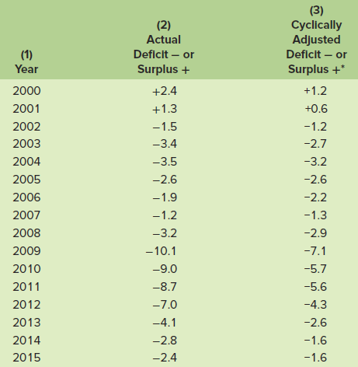
Recent U.S. Fiscal Policy
LO4
Notes:
This table shows Federal deficits (-) and surpluses (+) as percentages of GDP, 2000–2015. Observe that the cyclically adjusted deficits are generally smaller than the actual deficits. This is because the actual deficits include cyclical deficits, whereas the cyclically adjusted deficits eliminate them. The expansionary fiscal policy of the early 1990s became contractionary from 1999 to 2001. In 2002 President Bush passed tax cuts and increased unemployment benefits, thereby increasing the cyclically adjusted deficit. The 2003 Bush tax cut increased the standardized budget deficit as a percentage of potential GDP. Federal budget deficits are expected to persist for many years to come.

Slide 14
Fiscal Policy: The Great Recession
Financial market problems began in 2007
Credit market freeze
Pessimism spreads to the overall economy
Recession officially began December 2007 and lasted 18 months
LO4
Notes:
In 2008 Congress passed an economic stimulus package of $152 billion consisting of checks to taxpayers, veterans, and social security recipients and some tax breaks for businesses. This package didn’t work to stimulate the economy as hoped. So in 2009, the American Recovery and Reinvestment Act was enacted and consisted of $787 billion of tax rebates and large amounts of government expenditures. This came after the government spent $700 billion for financial institutions in the TARP.

Slide 15
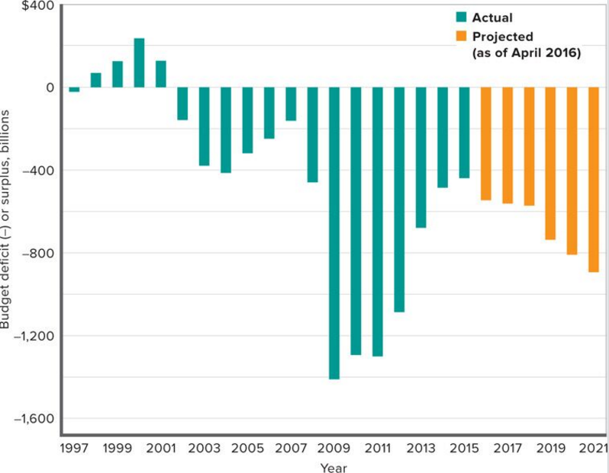
Budget Deficits and Projections
LO4
Notes:
This figure shows Federal budget deficits and surpluses, actual and projected, for fiscal years 1997-2021(in billions of nominal dollars).

Slide 16
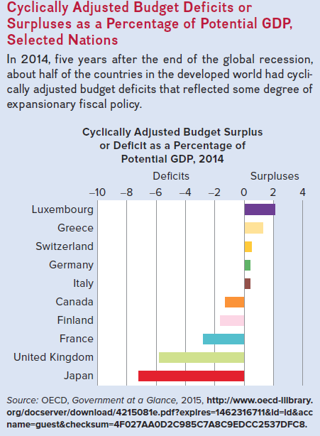
Global Perspective
LO4
Notes:
The Global Perspective shows cyclically adjusted budget deficits or surpluses as a percentage of potential GDP for selected nations. In 2014, five years after the end of the global recession, about half of the countries in the developed world had cyclically adjusted budget deficits that reflected some degree of expansionary fiscal policy.

Slide 17
Problems, Criticisms, and Complications
Problems of Timing
Recognition lag
Administrative lag
Operational lag
Political business cycles
Future policy reversals
Off-setting state and local finance
Crowding-out effect
LO5
Notes:
Recognition lag is the elapsed time between the beginning of a recession or inflation and awareness of this occurrence. The lag between the time the need for fiscal policy is recognized and the time action is taken is referred to as administrative lag. Operational lag is the time elapsed between the change in policy and its impact on the economy.
A political business cycle may destabilize the economy: election years have been characterized by more expansionary policies regardless of economic conditions.
Households may believe that the tax reduction is temporary and save a large portion of their tax cut, reducing the magnitude of the effect desired by policy makers.
State and local finance policies may offset federal stabilization policies. They are often procyclical because balanced-budget requirements cause state and local governments to raise taxes in a recession or cut spending making the recession possibly worse. In an inflationary period, they may increase spending or cut taxes as their budgets head for a surplus.
“Crowding‑out” may occur with government deficit spending. It may increase the interest rate and reduce private spending which weakens or cancels the stimulus of fiscal policy.

Slide 18
Current Thinking on Fiscal Policy
Let the Federal Reserve handle short-term fluctuations
Fiscal policy should be evaluated in terms of long-term effects
Use tax cuts to enhance work effort, investment, and innovation
Use government spending on public capital projects
LO5
Notes:
Some economists oppose the use of fiscal policy, believing that monetary policy is more effective, or that the economy is sufficiently self-correcting.
Most economists support the use of fiscal policy to help “push the economy” in a desired direction, and the use of monetary policy more for “fine tuning.”
Economists agree that the potential impacts (positive and negative) of fiscal policy on long-term productivity growth should be evaluated and considered in the decision-making process, along with the short-run cyclical effects.

Slide 19
The U.S. Public Debt
$18.2 trillion in 2015
The accumulation of years of federal deficits and surpluses
Owed to the holders of U.S. securities
Treasury bills
Treasury notes
Treasury bonds
U.S. savings bonds
LO6
Notes:
The national or public debt is the total accumulation of the Federal government’s total deficits and surpluses that have occurred through time. Deficits (and by extension the debt) are the result of war financing, recessions, and lack of political will to reduce or avoid them.
Treasury bills are short-term securities.
Treasury notes are medium-term securities.
Treasury bonds are long-term securities.
U.S. savings bonds are long-term, non-marketable securities.

Slide 20
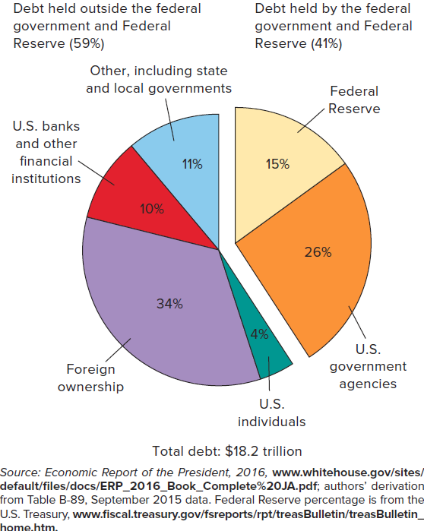
The U.S. Public Debt Continued
LO6
Notes:
This figure shows the ownership of the total public debt, 2015.

Slide 21
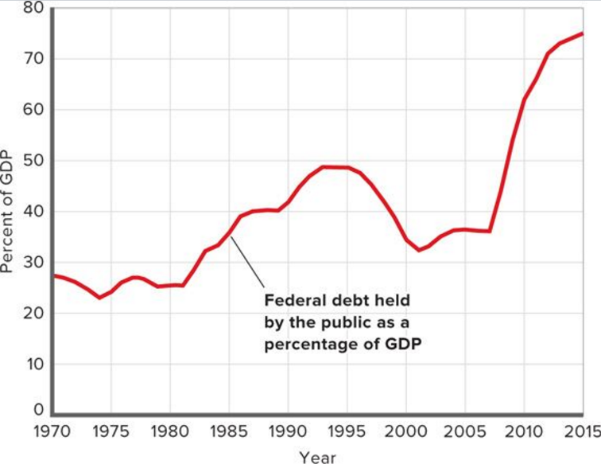
The U.S. Public Debt Concluded
LO6
Notes:
This figure shows the federal debt held by the public, excluding the Federal Reserve, as a percentage of GDP, 1970-2015.

Slide 22
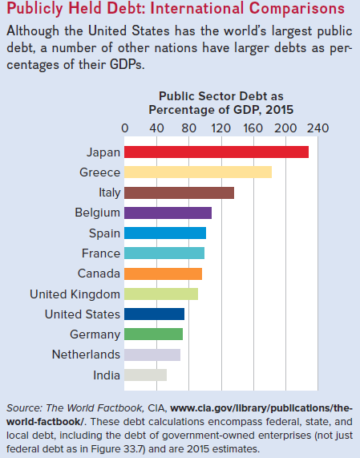
Global Perspective 2
LO6
Notes:
Global Perspective: Publicly Held Debt: International Comparisons
Although the U.S. has the highest public debt in absolute terms, a number of countries owe more relative to their ability to support it (through income, or GDP).

Slide 23
The U.S. Public Debt Concerns
Interest charges on debt
Largest burden of the debt
2.2% of GDP in 2015
False Concerns
Bankruptcy
Refinancing
Taxation
Burdening future generations
LO6
Notes:
Interest charges are the main burden imposed by the debt because government always has to at least pay the interest on their debt in order to remain in good credit standing.
Can the federal government go bankrupt? There are reasons why it cannot.
The government can raise taxes to pay back the debt, and it can borrow more (i.e. sell new bonds) to refinance bonds when they mature. Corporations use similar methods — they almost always have outstanding debt. Of course, refinancing could become an issue with a high enough debt-to-GDP ratio. Some countries, such as Greece, have run into this problem. High and rising ratios in the United States might raise fears that the U.S. government might be unable to pay back loans as they come due. But, with the present U.S. debt-to-GDP ratio and the prospects of long-term economic growth, this is a false concern for the United States.
The government has the power to tax, which businesses and individuals do not have when they are in debt.
Does the debt impose a burden on future generations? In 2015 the per capita federal debt in U.S. was $56,368. But the public debt is a public credit — your grandmother may own the bonds on which taxpayers are paying interest. Some day you may inherit those bonds that are assets to those who have them. The true burden is borne by those who pay taxes or loan government money today to finance government spending. If the spending is for productive purposes, it will enhance future earning power and the size of the debt relative to future GDP and population could actually decline. Borrowing allows growth to occur when it is invested in productive capital.

Slide 24
Substantive Issues
Income distribution
Incentives
Foreign-owned public debt
Crowding-out effect revisited
Future generations
Public investment
LO6
Notes:
Repayment of the debt affects income distribution. If working taxpayers will be paying interest to the mainly wealthier groups who hold the bonds, this probably increases income inequality.
Since interest must be paid out of government revenues, a large debt and high interest can increase the tax burden and may decrease incentives to work, save, and invest for taxpayers.
A higher proportion of the debt is owed to foreigners (about 29 percent) than in the past, and this can increase the burden since payments leave the country. But Americans also own foreign bonds and this offsets the concern.
Some economists believe that public borrowing crowds out private investment, but the extent of this effect is not clear. See the next slide for the graph.
There are some positive aspects of borrowing even with crowding-out. If borrowing is for public investment that causes the economy to grow more in the future, the burden on future generations will be less than if the government had not borrowed for this purpose. Public investment makes private investment more attractive. For example, new federal buildings generate private business; good highways help private shipping, etc.

Slide 25
Crowding-Out Effect
16
14
Increase in
investment
demand
12
b
c
10
Real interest rate (percent)
8
a
6
Crowding-out
effect
4
2
ID₂
ID₁
0
5
10
15
20
25
30
35
40
Investment (billions of dollars)
LO6
Notes:
This figure shows the investment demand curve and the crowding-out effect. If the investment demand curve (ID₁) is fixed, the increase in the interest rate from 6 percent to 10 percent caused by financing a large public debt will move the economy from a to b, crowding out $10 billion of private investment, and decreasing the size of the capital stock inherited by future generations. However, if the public goods enabled by the debt improve the investment prospects of businesses, the private investment demand curve will shift rightward, as from ID₁ to ID₂. That shift may offset the crowding-out effect wholly or in part. In this case, it moves the economy from a to c.

Slide 26
Social Security, Medicare Shortfalls
More Americans will be receiving benefits as they age
Social security shortfalls
Income during retirement
Funds will be depleted by 2033
Medicare shortfalls
Medical care during retirement
Funds will be depleted by 2024
Notes:
Social Security is the major public retirement program in the United States. Half of the tax (6.2%) is paid by individuals and half is paid by employers (another 6.2%).
The Medicare program is the health care program for people age 65 and older in the United States. Half of the tax (1.45 %) is paid by individuals and half is paid by employers (another 1.45%).
There is an impending long-run shortfall in Social Security funding. It is a “pay-as-you-go” system, meaning that current revenues are used to pay current retirees (instead of paying from funds accumulated over time). Despite efforts to build a trust fund, eventually Social Security revenues will fall below payouts to retirees. Baby boomers are entering retirement age and living longer, meaning that there will be more recipients receiving payouts for longer periods of time.
The ratio of the number of workers contributing to the system for each recipient has declined.

Slide 27
Social Security, Medicare Shortfalls Continued
Possible options “to fix” include:
Increasing the retirement age
Increasing the portion of earnings subject to the social security tax
Disqualifying wealthy individuals
Redirecting low-skilled immigrants to higher-skilled, higher paying work
Defined contribution plans owned by individuals
Notes:
Numerous solutions have been suggested and each has an economic trade-off: reduce benefits by reducing direct payments, taxing benefits, and/or increasing the age at which workers are eligible to receive benefits (already part of the system), increase revenues by raising payroll taxes, increase the trust fund by setting aside more of current system revenues, or by investing trust fund monies in corporate stocks and bonds. Additionally, one solution is to allow workers to invest half of their payroll taxes in approved stock and bond funds — sometimes referred to as “privatizing” Social Security. There are many possible solutions, and the political process may well result in a combination of the many policies proposed.

