Slide 1
Chapter 24
Basic Macroeconomic Relationships
Notes:
This chapter introduces three basic macroeconomic relationships. First, the focus is on the income-consumption and income-saving relationships. Second, the relationship between the interest rate and investment is examined. Finally, the multiplier concept is developed, relating changes in spending to changes in output.

Slide 2
Income, Consumption, and Saving
Consumption and saving
Primarily determined by DI
Direct relationship
Consumption schedule
Planned household spending (in our model)
Saving schedule
DI minus C
Dissaving can occur
LO1
Notes:
DI represents disposable income (after-tax income) and is the most important determinant of C (consumption spending). What is not spent is called saving. Both consumption and saving are directly related to the level of income.
We can make the following conclusions:
Households consume a large portion of their disposable income and spend a larger proportion of a small disposable income than of a large disposable income.
Households save a smaller proportion of a small disposable income than of a large disposable income.
Dissaving is consuming in excess of disposable income. Households dissave by borrowing or by selling accumulated wealth (assets).

Slide 3
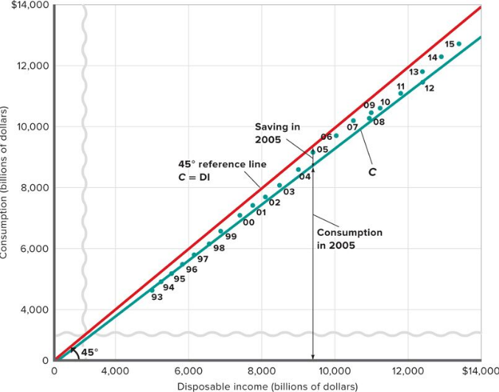
Consumption and Disposable Income
LO1
Notes:
This figure shows the consumption and disposable income for the U.S. for 1993-2015. Each dot in this figure shows consumption and disposable income in a specific year. The line, C, which generalizes the relationship between consumption and disposable income, indicates a direct relationship and shows that households consume most of their after-tax incomes.
This figure represents graphically the recent historical relationship between disposable income (DI), consumption (C), and saving (S) in the United States.
A 45-degree line represents all points where consumer spending is equal to disposable income. Other points represent actual C, DI relationships for each year.
If the actual graph of the relationship between consumption and income is below the 45-degree line, then the difference must represent the amount of income that is saved. Notice that consumption can exceed disposable income and personal saving can be negative.

Slide 4
Consumption and Saving Schedules
Consumption and Saving Schedules (in Billions) and Propensities to Consume and Save
(1) Level of Output and Income GDP = DI | (2) Consumption (C) | (3) Saving (S), (1) - (2) | (4) Average Propensity to Consume (APC), (2)/(1) | (5) Average Propensity to Save (APS), (3)/(1) | (6) Marginal Propensity to Consume (MPC), Δ(2)/Δ(1)* | (7) Marginal Propensity to Save (MPS), Δ(3)/Δ(1)*
(1) $370 | $375 | $-5 | 1.01 | -.01 | .75 | .25
390 | 390 | 0 | 1.00 | .00 | .75 | .25
410 | 405 | 5 | .99 | .01 | .75 | .25
430 | 420 | 10 | .98 | .02 | .75 | .25
450 | 435 | 15 | .97 | .03 | .75 | .25
470 | 450 | 20 | .96 | .04 | .75 | .25
490 | 465 | 25 | .95 | .05 | .75 | .25
510 | 480 | 30 | .94 | .06 | .75 | .25
530 | 495 | 35 | .93 | .07 | .75 | .25
(10) 550 | 510 | 40 | .93 | .07 | .75 | .25
LO1
Notes:
This table shows the consumption and saving schedules and propensities to consume and save (propensities to consume and save will be presented in later slides).
This hypothetical consumption schedule shows that households spend a larger proportion of a small income than of a large income based on the APC. Note that “dissaving” occurs at low levels of disposable income, where consumption exceeds income and households must borrow or use up some of their wealth.
The break-even income is where C = DI and S = 0. In this table, the break-even income occurs when DI = $390.

Slide 5
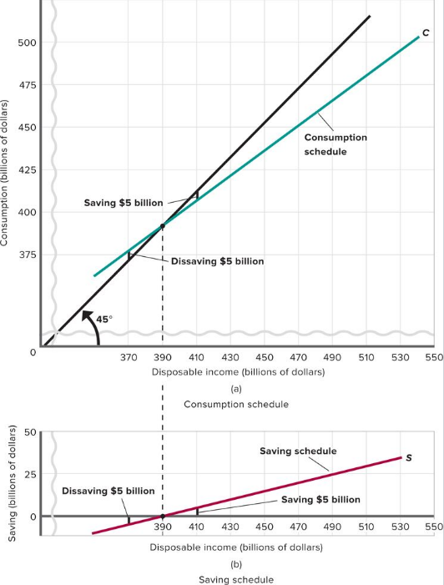
Consumption and Saving Schedules Cont’d
LO1
Notes:
This figure shows (a) consumption and (b) saving schedules. The two parts of this figure show the income-consumption and income-saving relationships graphically. The saving schedule in (b) is found by subtracting the consumption schedule in (a) vertically from the 45° line. Consumption equals disposable income (and saving, thus, equals zero) at $390 billion for this hypothetical data.

Slide 6
Average Propensities
Average propensity to consume (APC)
Fraction of total income consumed
Average propensity to save (APS)
Fraction of total income saved
consumption
saving
APC =
APS =
income
income
APC + APS = 1
LO1
Notes:
The definition of the average propensity to consume (APC) is the fraction, or percentage, of income consumed (APC = consumption/income). If you multiply the fraction by 100 you can express this as a percentage. The definition of the average propensity to save (APS) is a the fraction, or percentage, of income saved (APS = saving/income). If you multiply the fraction by 100 you can express this as a percentage.

Slide 7
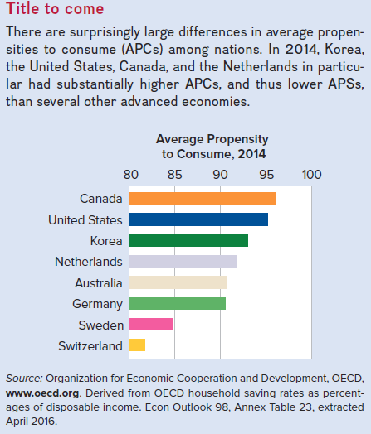
Global Perspective 1
LO1
Notes:
This Global Perspective shows the average propensities to consume for selected nations. There are surprisingly large differences in the average propensities to consume (APCs) among nations. In 2014, Canada and the United States, in particular, had substantially higher APCs, and thus lower APSs, than several other advanced economies.
Note the high APCs for Korea, the U.S., and Canada.
Note that APC + APS = 1.

Slide 8
Marginal Propensities
Marginal propensity to consume (MPC)
Proportion of a change in income consumed
Marginal propensity to save (MPS)
Proportion of a change in income saved
change in consumption
change in saving
MPC =
MPS =
change in income
change in income
MPC + MPS = 1
LO1
Notes:
Marginal propensity to consume (MPC) is the fraction or proportion of any change in income that is consumed. (MPC = change in consumption/change in income.) Marginal propensity to save (MPS) is the fraction or proportion of any change in income that is saved. (MPS = change in saving/change in income.) Note that MPC + MPS = 1.

Slide 9
Marginal Propensities Continued
15
20
C
MPC =
= .75
Consumption
ΔC ($15)
ΔDI ($20)
5
20
S
MPS =
= .25
Saving
ΔS ($5)
ΔDI ($20)
LO1
Disposable income
Notes:
This figure shows the marginal propensity to consume and the marginal propensity to save as the slopes of the consumption and savings schedules. The MPC is the slope of the consumption schedule and the MPS is the slope of the saving schedule. The Greek letter delta means “the change in.”

Slide 10
Nonincome Determinants
Amount of disposable income is the main determinant
Other determinants
Wealth
Borrowing
Expectations
Real interest rates
LO2
Notes:
Nonincome determinants of consumption and saving can cause people to spend or save more or less at various income levels, although the level of income is the basic determinant.
Wealth: An increase in wealth shifts the consumption schedule up and the saving schedule down. In recent years, major fluctuations in stock market values have increased the importance of this wealth effect. A “reverse wealth effect” occurred in 2000 and 2001 when stock prices fell dramatically.
Household debt: Lower debt levels shift the consumption schedule up and the saving schedule down.
Expectations: Changes in expected future prices or wealth can affect consumption spending today.
Real interest rates: Declining interest rates increase the incentive to borrow and consume, and reduce the incentive to save. Because many household expenditures are not interest sensitive — the electric bill, groceries, etc. — the effect of interest rate changes on spending are modest.

Slide 11
Other Important Considerations
Switching to real GDP
Changes along schedules
Simultaneous shifts
Taxation
Stability
LO2
Notes:
Macroeconomic models focus on real domestic output (real GDP) more than on disposable income. The figure on the next slide reflects this change in the labeling of the horizontal axis.
Changes along schedules: Movement from one point to another on a given schedule is called a change in the amount consumed. A shift in the schedule is called a change in the consumption schedule and is caused by one of the non-income determinants of consumption.
Schedule shifts: Consumption and saving schedules will always shift in opposite directions unless a shift is caused by a tax change.
Taxation: Lower taxes will shift both schedules up since taxation affects both spending and saving and vice versa for higher taxes.
Stability: Economists believe that the consumption and saving schedules are generally stable unless deliberately shifted by government action.

Slide 12
Shifts of Consumption and Saving Schedules
C₁
C₀
C₂
Consumption
(billions of dollars)
45°
0
S₂
S₀
+
S₁
Saving
(billions of dollars)
0
-
Real GDP (billions of dollars)
LO2
Notes:
This figure shows the shifts of the consumption and saving schedules. Normally, if households consume more at each level of real GDP, they are necessarily saving less. Graphically this means that an upward shift of the consumption schedule (C₀ to C₁) entails a downward shift of the saving schedule (S₀ to S₁). If households consume less at each level of real GDP, they are saving more. A downward shift of the consumption schedule (C₀ to C₂) is reflected in an upward shift of the saving schedule (S₀ to S₂). This pattern breaks down, however, when taxes change; then the consumption and saving schedules move in the same direction — opposite to the direction of the tax change.

Slide 13
Interest-Rate-Investment Relationship
Expected rate of return
The real interest rate
Investment demand curve
LO3
Notes:
Investment consists of spending on new plants, capital equipment, machinery, inventories, construction, etc. The investment decision weighs marginal benefits and marginal costs. The expected rate of return is the marginal benefit and the interest rate (the cost of borrowing funds) represents the marginal cost.
The expected rate of return is found by finding the expected economic profit (total revenue minus total cost) as a percentage of the cost of investment. The text’s example gives $100 expected profit on a $1000 investment, for a 10% expected rate of return. Thus, the business would not want to pay more than a 10% interest rate on the investment. Remember that the expected rate of return is not a guaranteed rate of return. Investment carries risk.
The real interest rate, i (nominal rate corrected for expected inflation), determines the cost of investment.
The interest rate represents either the cost of borrowed funds or the opportunity cost of investing your own funds, which is income forgone. If the real interest rate exceeds the expected rate of return, the investment should not be made.
The investment demand schedule, or curve, shows an inverse relationship between the interest rate and the amount of investment. As long as the expected return exceeds the interest rate, the investment is expected to be profitable.

Slide 14
Investment Demand Curve
(r) and (i) | Cumulative Amount at this ROR (billions of dollars)
16% | $ 0
14 | 5
12 | 10
10 | 15
8 | 20
6 | 25
4 | 30
2 | 35
0 | 40
16
14
12
10
8
6
4
2
0
Investment
demand
curve
Expected rate of return, r
and real interest rate, i (percents)
ID
5 10 15 20 25 30 35 40
Investment (billions of dollars)
LO3
Notes:
This figure, which can be found in the Key Graph section, shows the investment demand curve. The investment demand curve is constructed by arraying all potential investment projects in descending order of their expected rates of return. The curve slopes downward, reflecting an inverse relationship between the real interest rate (the financial “price” of each dollar of investing) and the quantity of investment demanded.

Slide 15
Shifts of Investment Demand
Acquisition, maintenance, and operating costs
Business taxes
Technological change
Stock of capital goods on hand
Planned inventory changes
Expectations
LO4
Notes:
Shifts in investment demand occur when any determinant apart from the interest rate changes. Greater expected returns create more investment demand, shifting the curve to the right. The reverse causes a leftward shift.
Changes in expected returns result because:
Acquisition, maintenance, and operating costs of capital goods may change. Higher costs lower the expected return.
Business taxes may change. Increased taxes lower the expected return.
Technology may change. Technological change often involves lower costs, which would increase expected returns.
Stock of capital goods on hand will affect new investment. If there is abundant idle capital on hand because of weak demand or recent investment, new investments would be less profitable.
If firms are planning on increasing their inventories, investment demand shifts to the right. If firms are planning to decrease their inventories, investment demand shifts left. These planned inventory changes are based on expectations of either faster or slower sales. If the firm expects faster sales in the future, they will add to inventory. If the firm expects slower sales in the future, they will decrease inventories.
Expectations about future economic and political conditions, both in the aggregate and in certain specific markets, can change the view of expected profits.

Slide 16
Shifts of Investment Demand Curve
Increase
in investment
demand
Expected rate of return, r, and
real interest rate, i (percents)
Decrease in
investment
demand
ID₂
ID₀
ID₁
0
Investment (billions of dollars)
LO4
Notes:
This figure shows the shifts of the investment demand curve. Increases in investment demand are shown as rightward shifts of the investment demand curve; decreases in investment demand are shown as leftward shifts of the investment demand curve.

Slide 17
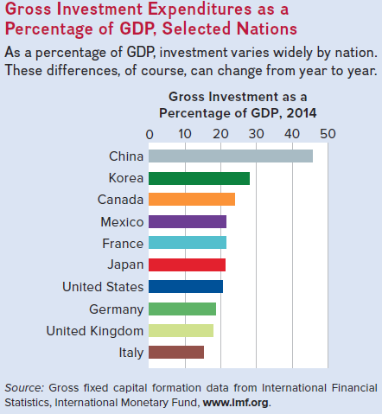
Global Perspective 2
LO4
Notes:
This Global Perspective shows gross investment expenditures as a percentage of GDP for selected nations for 2014. As a percentage of GDP, investment varies widely by nation. These differences, of course, can change from year to year.

Slide 18
Instability of Investment
Variability of expectations
Durability
Irregularity of innovation
Variability of profits
LO4
Notes:
Investment is a very unstable type of spending. I_{g} is more volatile than GDP. Expectations of future business conditions are easily and quickly changed. Capital goods are durable, so spending can be postponed or not. Firms can choose to replace or fix older equipment and buildings. This is unpredictable. Innovation occurs irregularly; new products stimulate investment and create waves of investment spending that in time recede. Profits affect both the incentive and ability to invest and profits vary considerably from year-to-year, contributing to the instability of investment spending.

Slide 19
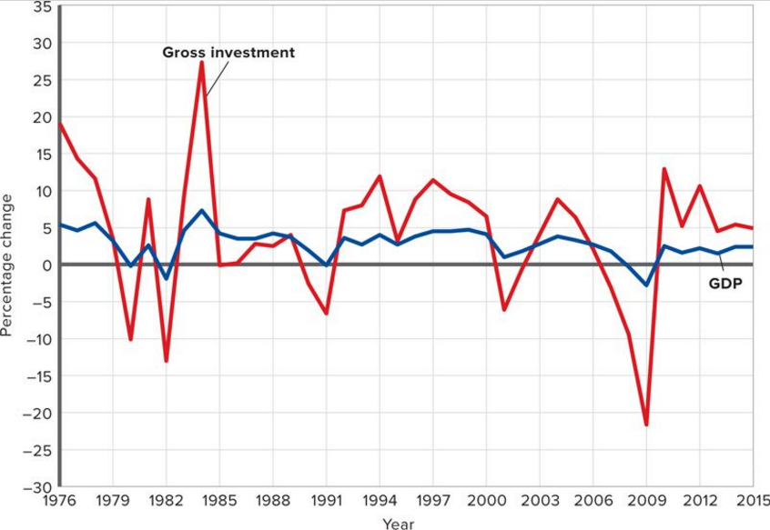
Volatility of Investment
LO4
Notes:
This figure shows the volatility of investment for the period 1976–2015. Annual percentage changes in investment spending are often several times greater than the percentage changes in GDP. (Data is represented in real terms. Investment is gross private domestic investment).

Slide 20
The Multiplier Effect
A change in spending changes real GDP more than the initial change in spending
change in real GDP
Multiplier =
initial change in spending
Change in GDP = multiplier × initial change in spending
LO5
Notes:
Changes in spending ripple through the economy to generate even larger changes in real GDP. This is called the multiplier effect.
Multiplier = change in real GDP / initial change in spending. Alternatively, it can be rearranged to read: change in real GDP = initial change in spending × multiplier.
Points to remember about the multiplier:
The initial change in spending is usually associated with investment because it is so volatile, but changes in consumption (unrelated to income), net exports, and government purchases also are subject to the multiplier effect.
The initial change refers to an up-shift or down-shift in the aggregate expenditures schedule due to a change in one of its components, like investment.
The multiplier works in both directions (up or down).
It occurs because of the interconnectedness of the economy.

Slide 21
The Multiplier Effect Continued
 | (1) Change in Income | (2) Change in Consumption (MPC = .75) | (3) Change in Saving (MPS = .25)
Increase in investment of $5.00 | $5.00 | $3.75 | $1.25
Second round | 3.75 | 2.81 | .94
Third round | 2.81 | 2.11 | .70
Fourth round | 2.11 | 1.58 | .53
Fifth round | 1.58 | 1.19 | .39
All other rounds | 4.75 | 3.56 | 1.19
Total | $20.00 | $15.00 | $5.00
20.00
15.25
13.67
11.56
8.75
5.00
$4.75
Cumulative income,
GDP
(billions of dollars)
$1.58
$2.11
$3.75
$2.81
$5.00
LO5
1
2
3
4
5
All others
Notes:
This figure illustrates the multiplier process with an MPC of .75. An initial change in investment spending of $5 billion creates an equal $5 billion of new income in round 1. Households spend $3.75 billion of this new income, creating $3.75 of added income in round 2. Of this $3.75 of new income, households spend $2.81 billion, and income rises by that amount in round 3. Such income increments over the entire process get successively smaller but eventually produce a total change of income and GDP of $20 billion. The multiplier therefore is 4.

Slide 22
Multiplier and Marginal Propensities
Multiplier and MPC directly related
Large MPC results in larger increases in spending
Multiplier and MPS inversely related
Large MPS results in smaller increases in spending
1
1
Multiplier =
Multiplier =
1- MPC
MPS
LO5
Notes:
The significance of the multiplier is that a small change in investment plans or consumption-saving plans can trigger a much larger change in the equilibrium level of GDP. The magnitude of the change in GDP is dependent on the size of the MPC and MPS.

Slide 23
Multiplier and Marginal Propensities Continued
MPC
Multiplier
.9
10
.8
5
.75
4
.67
3
.5
2
LO5
Notes:
This figure illustrates the relationship between the MPC and the multiplier. The larger the MPC (the smaller the MPS), the greater the size of the multiplier.

Slide 24
The Actual Multiplier Effect?
Actual multiplier is lower than the model assumes
Consumers buy imported products
Households pay income taxes
Inflation
Multiplier may be 0
LO5
Notes:
The actual multiplier in the U.S. (estimated to be between 2.5 and 0) is smaller than the model in this chapter because, in the U.S. economy, there are other leakages from the spending and income cycle besides just saving. Imports and taxes reduce the flow of money back into spending on domestically produced output, reducing the multiplier effect. Also, increases in spending can drive up prices (inflation) and at higher prices, any given amount of spending will buy less real output.

Slide 25
Squaring the Economic Circle
Humorous small town example of the multiplier
One person in town decides not to buy a product
Creates a ripple effect of people not spending, following the first decision
Ultimately the entire town experiences an economic downturn
Notes:
The central idea illustrated in this example is of the multiplier effect that exists in a market economic system. One independently determined change in spending has an effect on another’s income, which then sets in motion a chain of events whereby spending changes directly with the income changes. A decline in spending begins a chain of declines, or, in other words, the initial decrease in spending is multiplied in terms of the final effect of this single decision. This occurs because of the observation that any change in income causes a change in spending that is directly proportional to it. The multiplier effect helps us understand why there is a business cycle as opposed to a stable level of output growth from year to year. In the Buchwald piece, a “downturn” for one person became a downturn for everyone in that fictional economy. Likewise, if the story had begun with a burst of optimism and an increase in spending, it might have rippled through to expand everyone’s fortunes.
The multiplier intensifies the effect of a spending change, whether it is an increase or decrease.
The multiplier is based on two facts:
1. The economy has continuous flows of expenditures and income — a ripple effect — in which income received by one comes from money spent by another, and so forth.
2. Any change in income will cause both consumption and saving to vary in the same direction as the initial change in income.

