Slide 1
Chapter 22
Economic Growth
Notes:
We begin by defining ways that economic growth can be measured and the reasons that economic growth is desirable. Then we look at differences in economic growth across countries and examine the factors that have led to such varied growth. Standards of living can be quite different, but we will find that a country is not always destined to have high or low standards of living. Using a production possibilities curve, we look at the demand, supply, and efficiency factors that contribute to economic growth. Lastly we will look at variables that have led to productivity growth and discuss whether or not economic growth is sustainable.

Slide 2
Economic Growth
Increase in real GDP or real GDP per capita over some time period
Percentage rate of growth
Growth as a goal
Arithmetic of growth: Rule of 70
Approximate
number of years
required to double
real GDP
70
=
annual percentage rate
of growth
LO1
Notes:
Economists define and measure economic growth two different ways. The first is as an increase in real GDP over some time period and the second is as an increase in real GDP per capita over some time period. It typically is measured as a percentage rate of growth either on a quarterly or yearly basis.
During periods of recession, the growth rate will be negative instead of positive. Whether the first or second measure of determining growth is used depends on the circumstances. Looking at GDP per capita allows one to compare countries of different sizes. For country-to-country comparisons, real GDP is more useful. Generally speaking, growth in GDP is considered an economic goal. The expansion of total output relative to population results in higher standards of living. It lessens the burden of scarcity.

Slide 3
Economic Growth Continued
Growth in U.S. real GDP 1950-2015
Increased more than sevenfold
3.1% per year
Growth in U.S. real GDP per capita
Increased more than threefold
At roughly 2% per year
Qualifications
Improved products and services
Added leisure
Other impacts
LO1
Notes:
While both real GDP and real GDP per capita have increased over the past 60 years, this must be qualified in several ways. Because the numbers do not fully account for improvements in products and services, they tend to understate the growth of economic well-being. They also do not take into account that growth has occurred at the same time that there has been an increase in the amount of leisure time, so economic well-being is even further understated. The numbers fail to account for any environmental or quality of life impacts as well.

Slide 4
Economic Growth Concluded
Real GDP and Real GDP per Capita
LO1
Notes:
This table presents the growth in real GDP and real GDP per capita in the United States since 1950. Due to the population increase, real GDP per capita has increased at a slower pace than real GDP. Since the population has doubled, the rate of increase in real GDP per capita has been about half that of real GDP.

Slide 5
Modern Economic Growth
Began with the Industrial Revolution in late 1700s
Ongoing increases in living standards
Time for leisure
Social change
Democracy
Human lifespan doubled
LO2
Notes:
Prior to the Industrial Revolution, living standards were basically stagnant for long periods of time. Since then however, modern economic growth has been characterized by sustained and ongoing increases in the standard of living. This growth has dramatically affected cultural, social, and political arrangements. Countries experiencing modern economic growth have tended to move toward democratic forms of government, people’s life-spans have doubled, and ordinary people have been able to experience leisure time and the arts due to increased wealth and living standards.

Slide 6
Modern Economic Growth Continued
Began in Britain
Has spread slowly
Starting date main cause of worldwide differences in living standards
Catching up is possible
Leader countries invent technology
Follower countries adopt technology
Can grow faster
LO2
Notes:
Modern economic growth has been slow to spread from its British birthplace. While much of the Western world began to experience growth in the early 1800s, most of Asia did not experience it until the early 1900s. It has only been in the last few decades that nations in Africa have begun to see modern economic growth.
These discrepancies in growth rates have led to a great difference between the wealth of nations who have experienced modern economic growth and those that have not. While it is possible for those poorer nations to catch up, they typically must rely upon the help of the wealthier nations. The follower countries must copy the technological advances pioneered in the leader nations.

Slide 7
Comparative Modern Economic Growth
Real GDP Real GDP Average annual
per capita, per capita, growth rate,
Country 1960 2010 1960-2010
United States $ 14,766 $41,365 2.1%
United Kingdom 11,257 34,268 2.2
France 9,347 31,299 2.4 Ireland 6,666 34,877 3.3
Japan 5,472 31,477 3.5
Singapore 4,149 55,862 5.2
Hong Kong 3,849 38,865 4.6
South Korea 1,765 26,609 5.4
Note: GDP figures for all countries are measured in “international dollars” of equal value
to U.S. dollars in 2005.
Source: Penn World Table version 6.3, pwt.econ.upenn.edu. Used by permission of the
Center for International Comparisons at the University of Pennsylvania
LO2
Notes:
This table shows the real GDP per capita in 1960 and 2010 plus the average annual growth rates of real GDP per capita from 1960-2010 for selected countries. Note the vast differences in growth rates. The nations from Asia have experienced much higher growth rates since they are in a catch-up mode while those countries that have been experiencing modern economic growth for a longer time frame have lower rates.

Slide 8
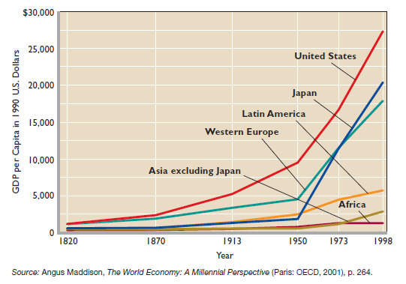
Modern Economic Growth Concluded
LO2
Notes:
This graph illustrates the large differences in the standards of living across nations. Before modern economic growth, the standards of living were much more equal, but with nations experiencing modern economic growth at different times, the standards of living vary greatly.

Slide 9
Institutional Structures of Growth
Strong property rights
Patents and copyrights
Efficient financial institutions
Literacy and widespread education
Free trade
Competitive market system
LO2
Notes:
There are several institutional structures that promote and sustain modern economic growth. Strong property rights are absolutely essential as people will not invest if they believe their investments are not safe from theft or an unscrupulous government. Patent and copyright laws are also necessary if a society wants a constant flow of innovative new technologies and sophisticated new ideas. Efficient financial institutions, literacy and education, free trade, and a competitive market system are other key factors in ensuring a nation’s ability to sustain growth.

Slide 10
Determinants of Growth
Supply factors
Increases in quantity and quality of natural resources
Increases in quality and quantity of human resources
Increases in the supply (or stock) of capital goods
Improvements in technology
LO3
Notes:
Four of the determinants of growth relate to the physical ability of the economy to expand. Any increases or improvements in these supply factors will increase the potential size of an economy’s GDP.

Slide 11
Determinants of Growth Continued
Demand factor
Households, businesses, and government must purchase the economy’s expanding output
Efficiency factor
Must achieve economic efficiency and full employment
LO3
Notes:
The fifth determinant of economic growth is the demand factor. To achieve the higher production potential created by the supply factors, households, businesses, and government must also expand their purchases of goods and services.
The sixth factor, efficiency, involves the issue that the economy must achieve economic efficiency as well as full employment. It must use its resources in the least costly way to provide the specific mix of goods and services that maximizes people’s well-being.

Slide 12
Production Possibilities
From Chapter 1:
C
A
Economic
Growth
Capital Goods
c
b
a
B
D
Consumer Goods
LO3
Notes:
12
Economic growth is made possible by the four supply factors that shift the production possibilities curve outward, as from AB to CD. Economic growth is realized when the demand factor and the efficiency factor move the economy from points such as a and c that are inside CD to the optimal output point, which is assumed to be point b in this figure. Point c represents situations in which real output falls below what it should have been if the economy was operating at full employment. This situation occurred during the severe recession of 2007-2009.

Slide 13
Labor and Productivity
Real GDP = hours of work × labor productivity
Size of employed labor force
Labor
Inputs
(hours of
work)
Average hours of work
×
=
Real
GDP
Technological advance
Quantity of capital
Education and training
Allocative efficiency
Other
Labor
Productivity
(average output per hour)
LO3
Notes:
Society can increase its real output and income in one of two ways: (1) by increasing its inputs of resources and (2) by raising the productivity of those inputs. By focusing on the labor input, we can build a framework for discussing the role of supply factors in growth. In this illustration, a nation’s economic growth from one year to the next depends on its increase in labor inputs and its increase in labor productivity.

Slide 14
U.S. Economic Growth
Accounting for the Growth of U.S. Real GDP, 1953-2015, Plus Projection from 2015-2026
(Average Annual Percentage Changes)
Item | 1953 Q2 To 1973 Q4 |  |  | 1973 Q4 To 1995 Q2 | 1995 Q2 To 2007 Q3 | 2007 Q3 To 2015 Q3 | Projected 2015 Q3 To 2026 Q4
Increase in real GDP |  | 3.6 | 2.8 |  | 3.2 | 1.2 | 2.4
Increase in quantity of labor |  | 1.1 | 1.3 |  | 0.5 | 0.1 | 0.3
Increase in labor productivity |  | 2.5 | 1.5 |  | 2.7 | 1.1 | 2.1
Source: Derived from Economic Report of the President, 2008, p. 45; Economic Report of the President, 2016, p. 113; Bureau of Economic Analysis; and Bureau of Labor Statistics.
LO3
Notes:
By looking at these numbers, it is clear that both increases in the quantity of labor and increases in labor productivity are important sources of economic growth. Between 1953 and 2015, the labor force increased from 63 million to 158 million workers. Productivity growth has usually been the more significant factor.

Slide 15
Accounting for Growth
Factors affecting productivity growth
Technological advance (40%)
Quantity of capital (30%)
Education and training (15%)
Economies of scale and resource allocation (15%)
LO4
Notes:
There are five factors that, when combined, appear to explain changes in productivity growth rates. The largest contributor is technological advance which accounts for approximately 40% of productivity growth. It is generated by the discovery of new knowledge. The quantity of capital explains roughly 30% of productivity growth. More and better plant and equipment make workers more productive. Education and training, economies of scale, and resource allocation account for the remaining productivity growth. Investment in human capital is an important means of increasing labor productivity.
By 2015, 88% of the U.S. population had at least a high school education and 33% had a college or post-secondary education, both representing substantial increases over the past several decades. Economies of scale are the reductions in per-unit production costs that result from increases in output levels. Improved resource allocation means workers over time have moved from low-productivity employment to high-productivity employment. The long-run movement toward liberalized international trade through international agreements has improved the allocation of resources, increased labor productivity, and expanded real output, both here and abroad.

Slide 16
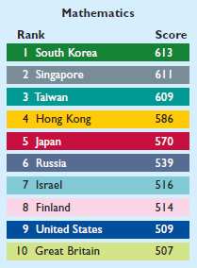
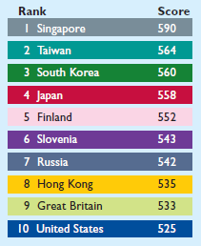
Accounting for Growth Continued
Average Test Scores of Eighth Grade
Students in Math and Science, 2011
Mathematics
Science
LO4
Notes:
The test performance of U.S. eighth-grade students did not compare favorably with that of eighth-graders in several other nations in the Fourth International Math and Science Study from 2011. In Mathematics, the United States came in 9th and in Science, 10th.

Slide 17
Productivity Growth
Average rate of growth
1.5% per year 1973-1995
2.6% per year 1995-2010
0.4% per year 2010-2015
Affects real output, real income, and real wages
Pay higher wages without lowering profit
LO5
Notes:
As measured by changes in the index of labor productivity, the growth rate doubled in the period of 1995-2012 as compared to the period of 1973-1995. Economists relate the increase to the significant wave of new technology coupled with global competition. The increase in productivity growth is important as real output, real income, and real wages are all linked to it. It is the main route for improving the standards of living for a nation’s workers.

Slide 18
Productivity Growth Continued
Microchip and information technology
Start-up firms and increasing returns
Sources of increasing returns
More specialized inputs
Spreading of development costs
Simultaneous consumption
Network effects
Learning by doing
Global competition
LO5
Notes:
So what are some of the reasons for the increased productivity growth? A core element was the explosion of entrepreneurship and innovation based on the development of the microchip. Microchips have found their way into thousands of products and changed the way business is conducted. Hundreds of new start-up firms aided in the advancement of the new information technology. These new firms took advantage of increasing returns and economies of scale as they helped to increase labor productivity. Global competition fueled by the collapse of the socialist economies was another key factor in the increasing rate of labor productivity growth.

Slide 19
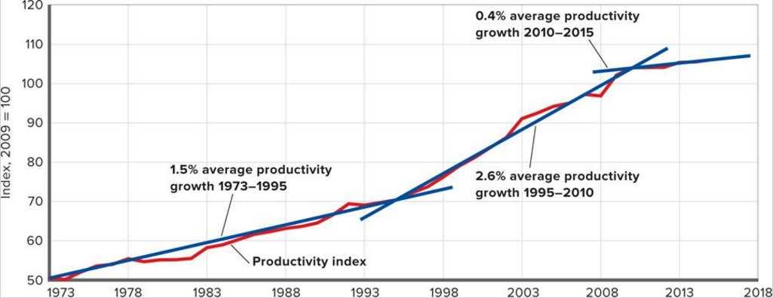
Productivity Growth Concluded
LO5
Notes:
This graph reflects the growth in U.S. productivity between 1973 and 2015. Average productivity was 1.5% until 1995, but after 1995 the average productivity growth rate increased to 2.4% decreasing to just 0.4% per year after the Great Recession of 2007-2009.

Slide 20
Productivity Slowdown
High debt levels
Overcapacity
Free Internet Apps
Slowdown in technological progress
LO5
Notes:
It is not clear why productivity rates have slowed during the past five years. It may be that the growth seen in 1995-2010 was an anomaly brought about by the information technology revolution but that alone would not explain why rates have now dropped below the pre-revolution growth rates. Several explanations have been offered to explain this change. The first is that the high debt levels accumulated by individuals and firms prior to the Great Recession may be to blame. Another explanation is that there is an excess of capacity existing which makes firms reluctant to purchase newer, more productive equipment. Many new products being created are technology-based and offered free to consumers so they are not measured in GDP. And finally, technological progress just may be at a stall, meaning growth will continue to stagnate until invention and innovation speed up again.

Slide 21
Global Competitiveness Index
LO6
Notes:
The Global Perspective lists the top 10 countries based on the global competitiveness index. The index uses factors like innovativeness, the capability to transfer technology among sectors, efficiency of the financial system, rates of investment, and the degree of integration with the rest of the world.

Slide 22
Is Growth Desirable?
The antigrowth view
Environmental and resource issues
In defense of economic growth
Higher standard of living
Human imagination can solve environmental and resource issues
LO6
Notes:
While most economists usually agree that economic growth is both desirable and sustainable, not everyone agrees. Critics say industrialization and growth come with pollution, climate changes, ozone depletion, and other environmental problems. They also argue that there is little compelling evidence that economic growth has solved sociological problems such as poverty, homelessness, and discrimination. While growth has led to higher standards of living, it does not necessarily translate to a better life. There is also concern about whether the growth is sustainable. The earth has limited resources which are being consumed at alarming rates.

Slide 23
Economic Growth Defense
Growth is the path to greater material abundance
Results in higher standards of living
Increases leisure time
Allows for the expansion and application of human knowledge
LO6
Notes:
Proponents of growth meet all of the arguments of critics with the upside of the situation. They point to the higher education levels, increased recreation, better access to medical care, and other benefits of modern society. They feel that the concerns about the environment can be dealt with as technology advances. The automobile industry illustrates that very issue with the movement towards vehicles that use alternative fuels rather than the limited fossil fuels.

Slide 24
Can Economic Growth Survive Population Decline?
As nations industrialize, their economies shift from agriculture to industry
Fertility rates fall
Decrease in population
Each generation smaller than the one before
Inverse dependency ratio
Social security issues
Innovation and productivity
Notes:
As nations shift from agriculture to industry, fertility levels plummet and birthrates fall dramatically. So, the labor force is shrinking while the population swells; resulting in each generation being smaller than the one before. This trend is known as the inverse dependency ratio. If productivity does not keep up with the fall of this ratio, some economists believe that living standards will decline. The place where this problem will show up first is Social Security. There may also be less innovation and slower productivity growth. Other economists are more hopeful, and believe that productivity growth and living standards could keep on rising at the rates we have come to expect.

